Slide 1
CAR SHOWROOM SERVICE MANAGEMENT
SYSTEM
KEERTHANA V M
S3 MCA
N0 : 35

Slide 2
INTRODUCTION
Car showroom service management system is aimed to serve the interest of customer and cover a widely distributed system.
It computerize the service management process of car showrooms.
Customer can book their slot for car service, fill up requirements and post complaints.
Customer can view the service details over the past years.
Customer id is given at the time of purchasing using this id customer can login to the website.

Slide 3
EXISTING SYSTEM
Complaints are recorded manually.
Time consuming.
Customer has no provision to know the status of complaints.
Customer cannot access the details of service.
Maintenance and modification of the record is difficult.

Slide 4
PROPOSED SYSTEM
Customer can book the service date.
Customer can register complaints through website.
Can view the current status of complaint.
Can view the service details from the time of purchasing to the last service date .
Faster response to customer complaints

Slide 5
USE CASE DIAGRAM
Login
Product Entry
Product View and Edit
SE and User Registration
Assign Job to SE
Administrator
Complaint View
Change Password

Slide 6
Login
View Assigned Job and complaints
Update Service details
Service Engineer
Change Password

Slide 7
Login
Book Service Date & Requirements
View Service details
Post Complaints
View Status
Customer
Change Password

Slide 8
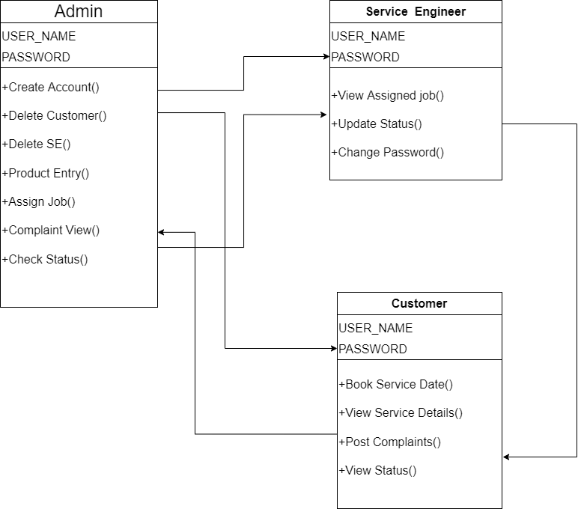
CLASS DIAGRAM

Slide 9
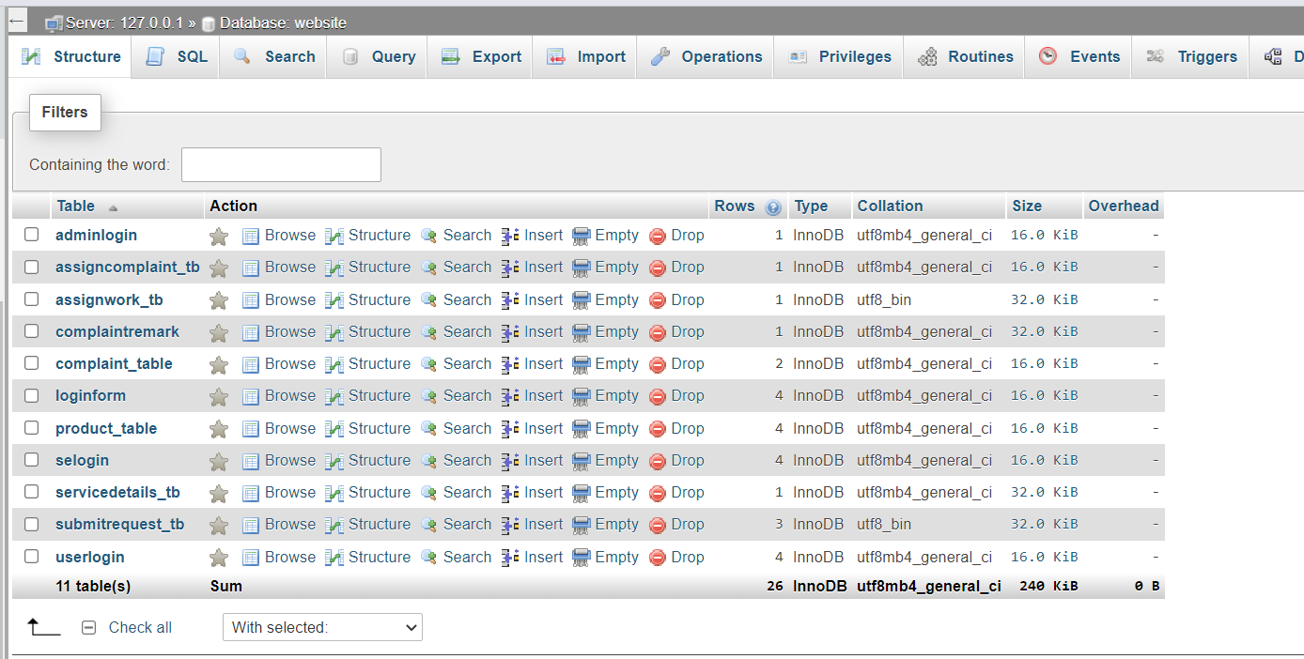
Database : Website

Slide 10
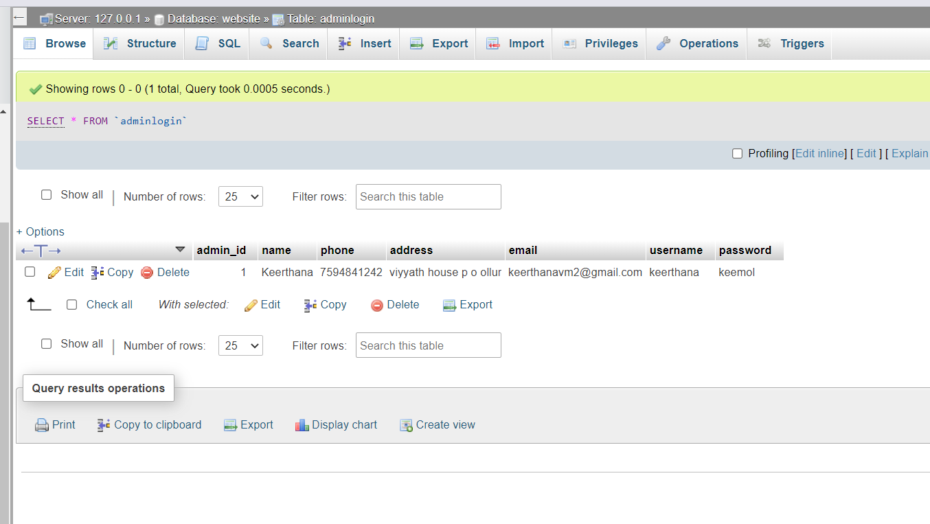

Slide 11
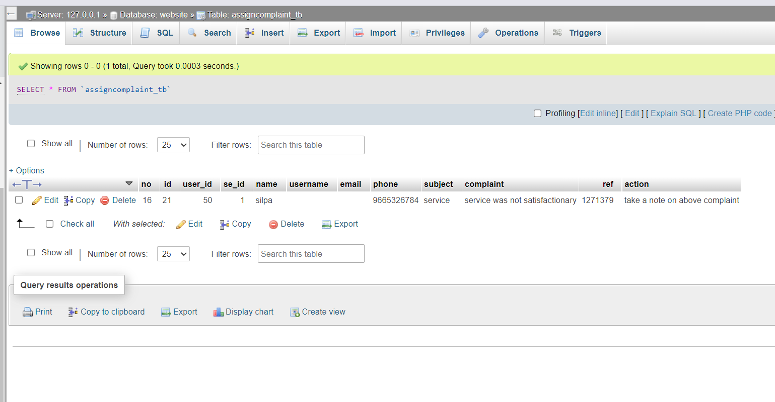

Slide 12
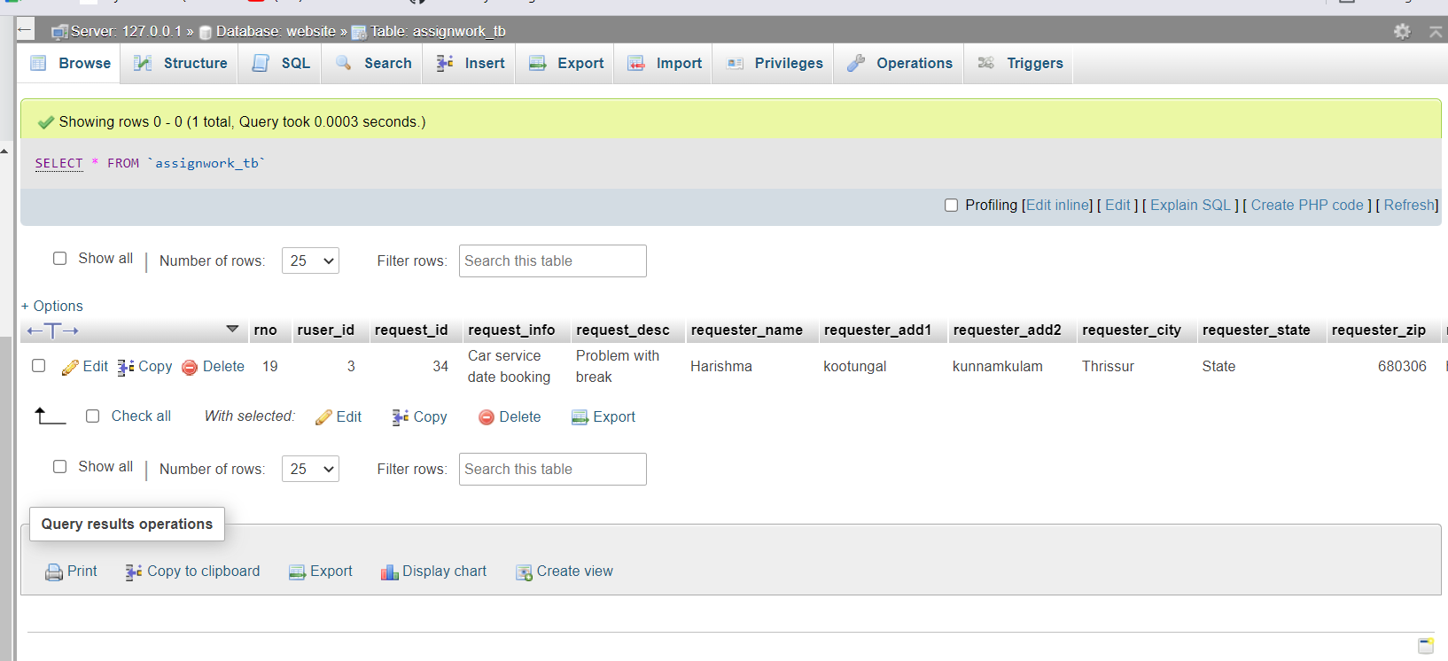

Slide 13
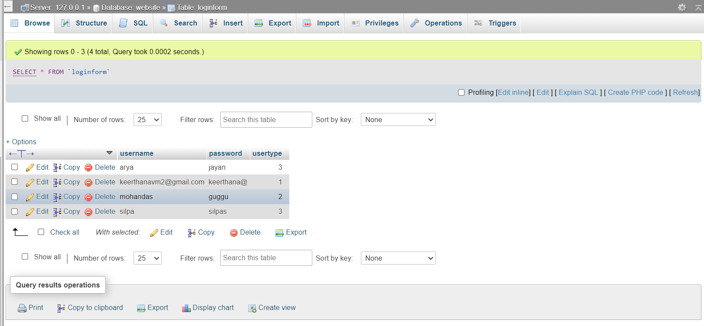

Slide 14
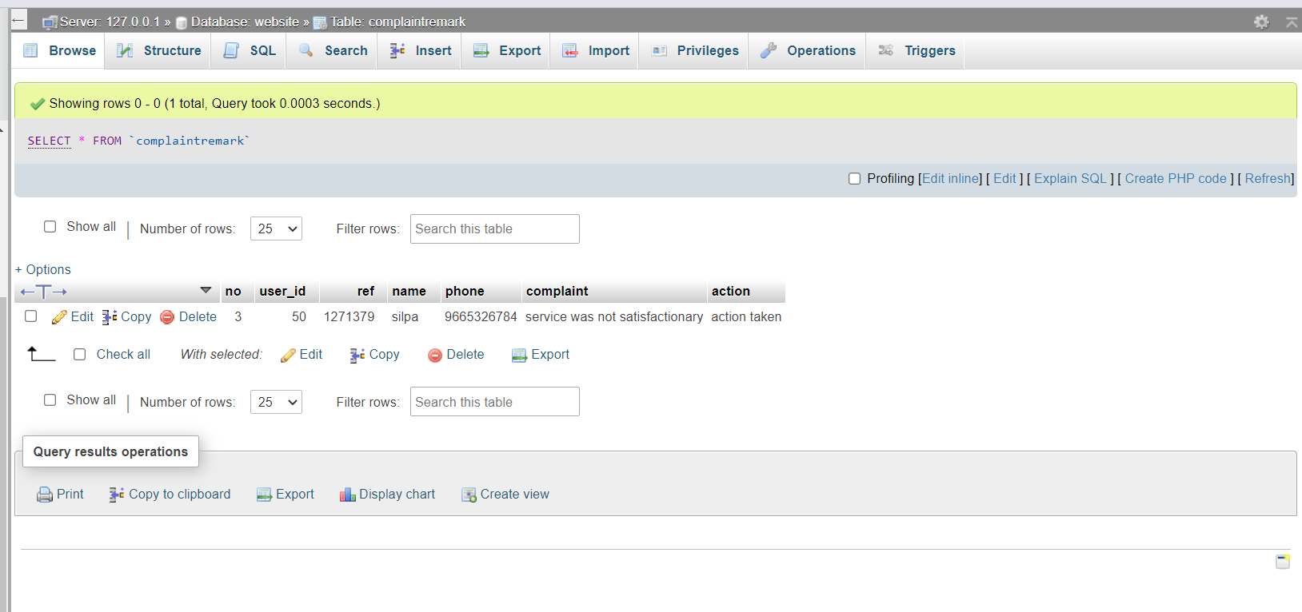

Slide 15
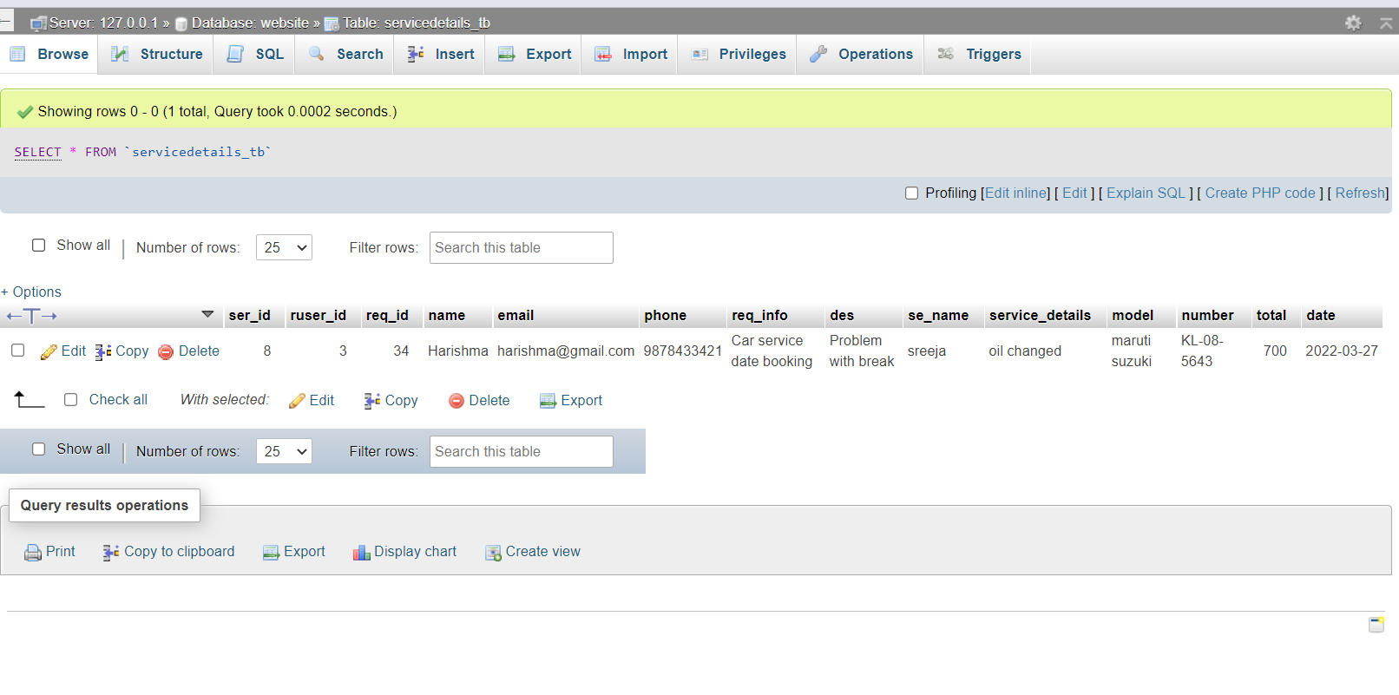

Slide 16
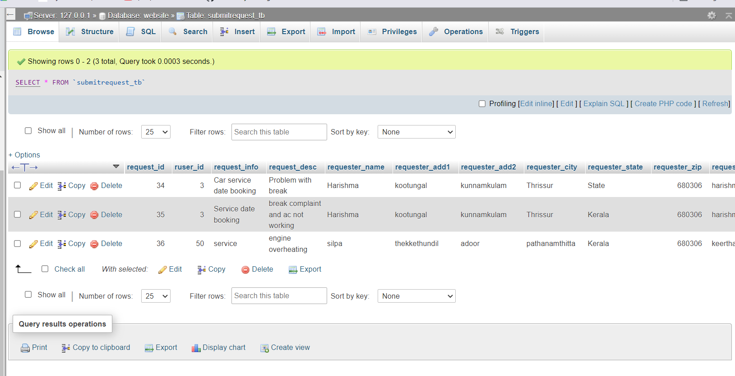

Slide 17
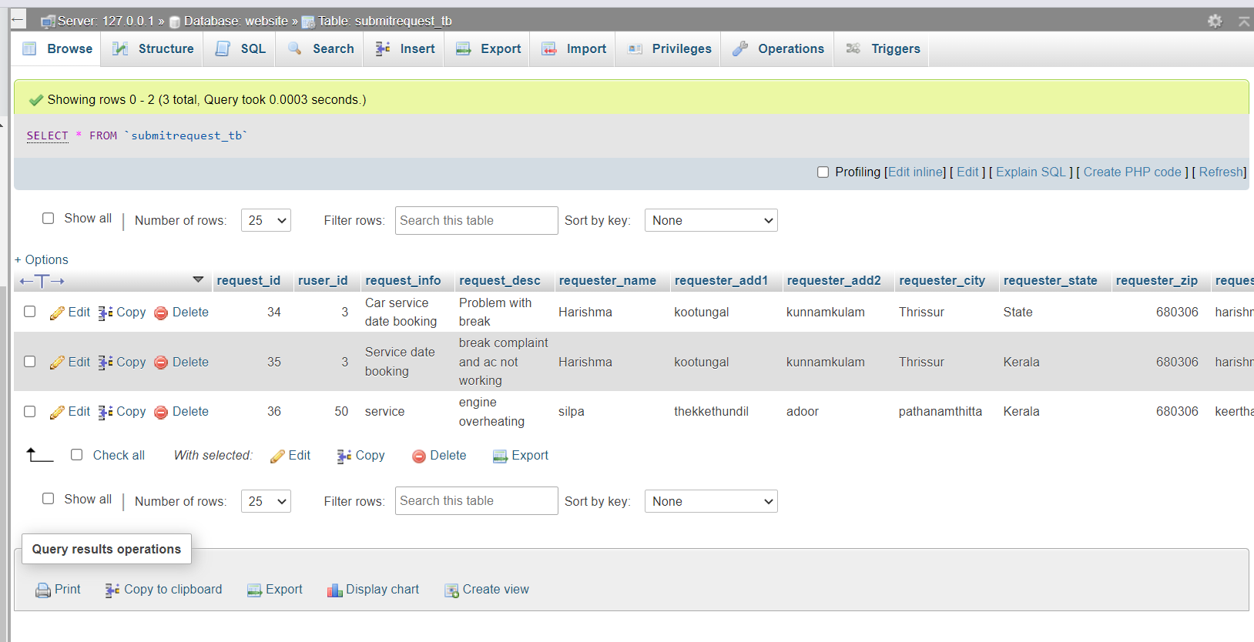

Slide 18
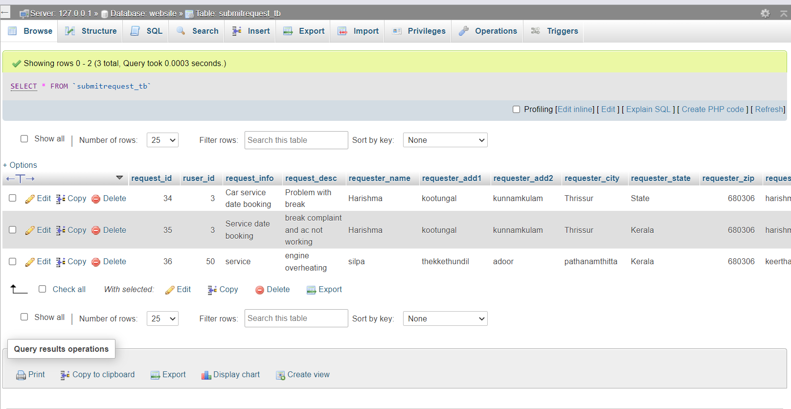

Slide 19
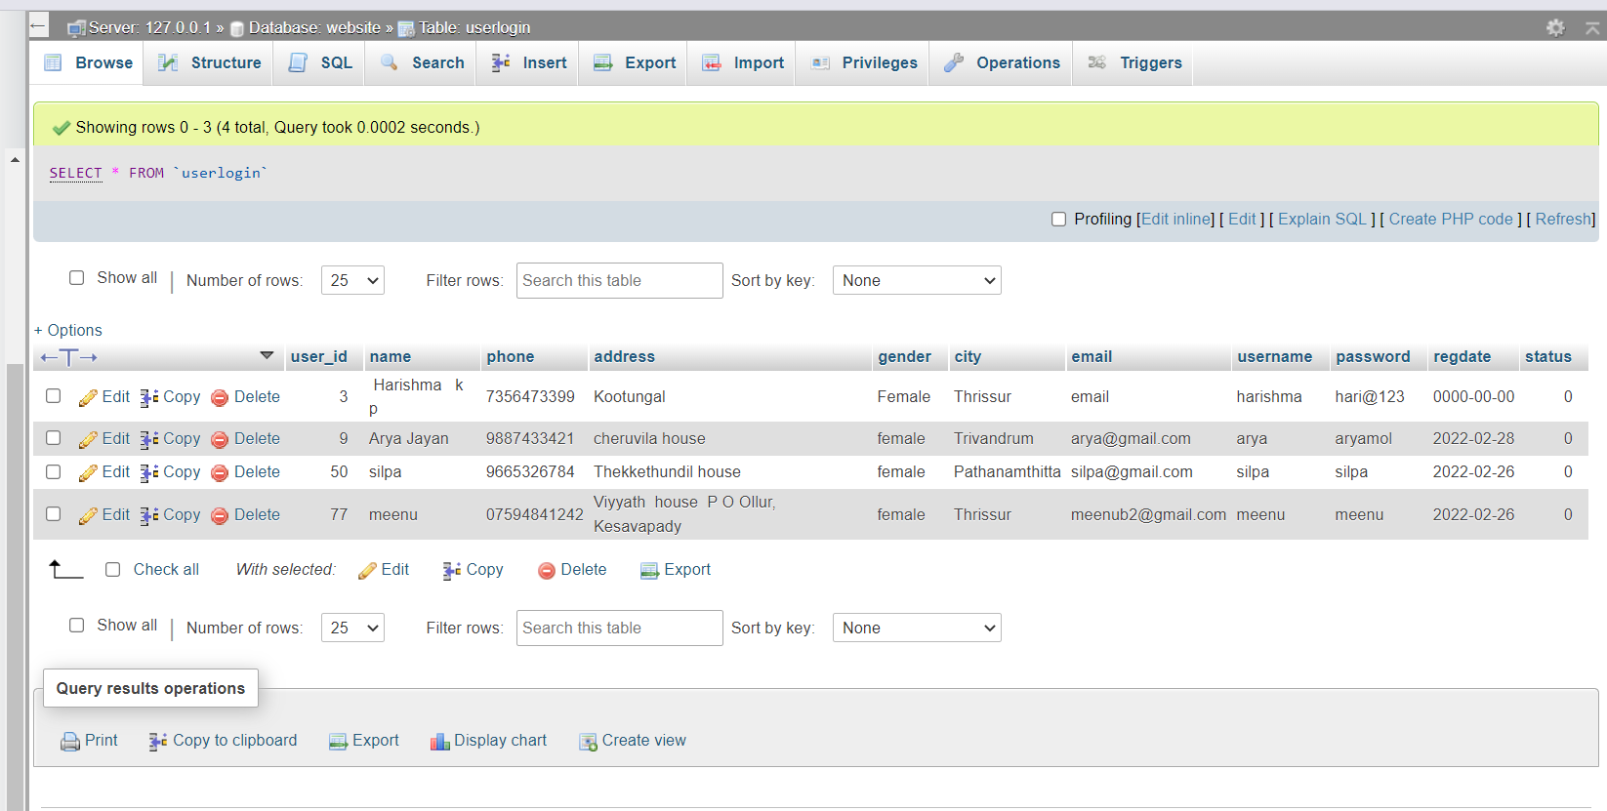

Slide 20
User Interface

Slide 21
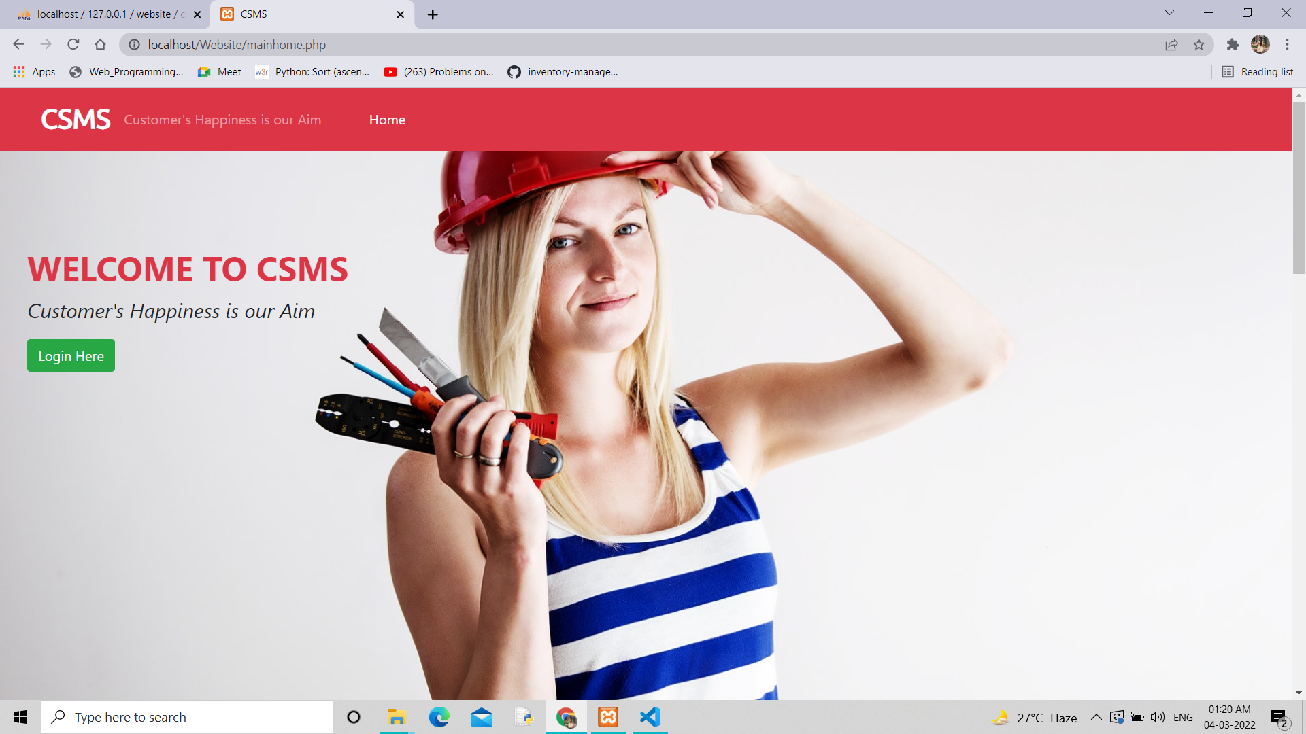

Slide 22
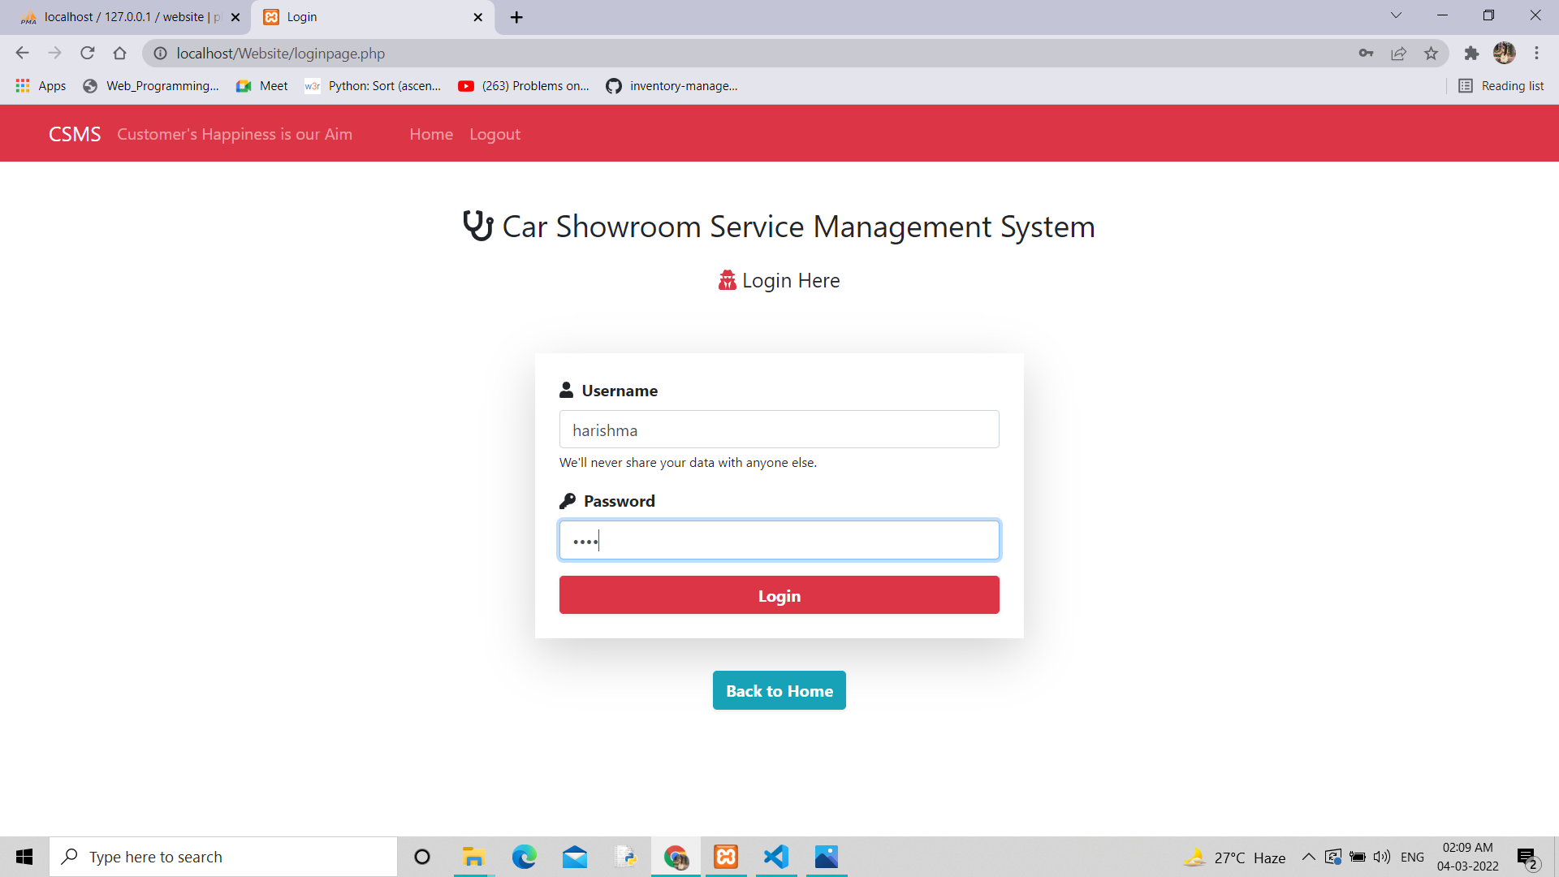

Slide 23
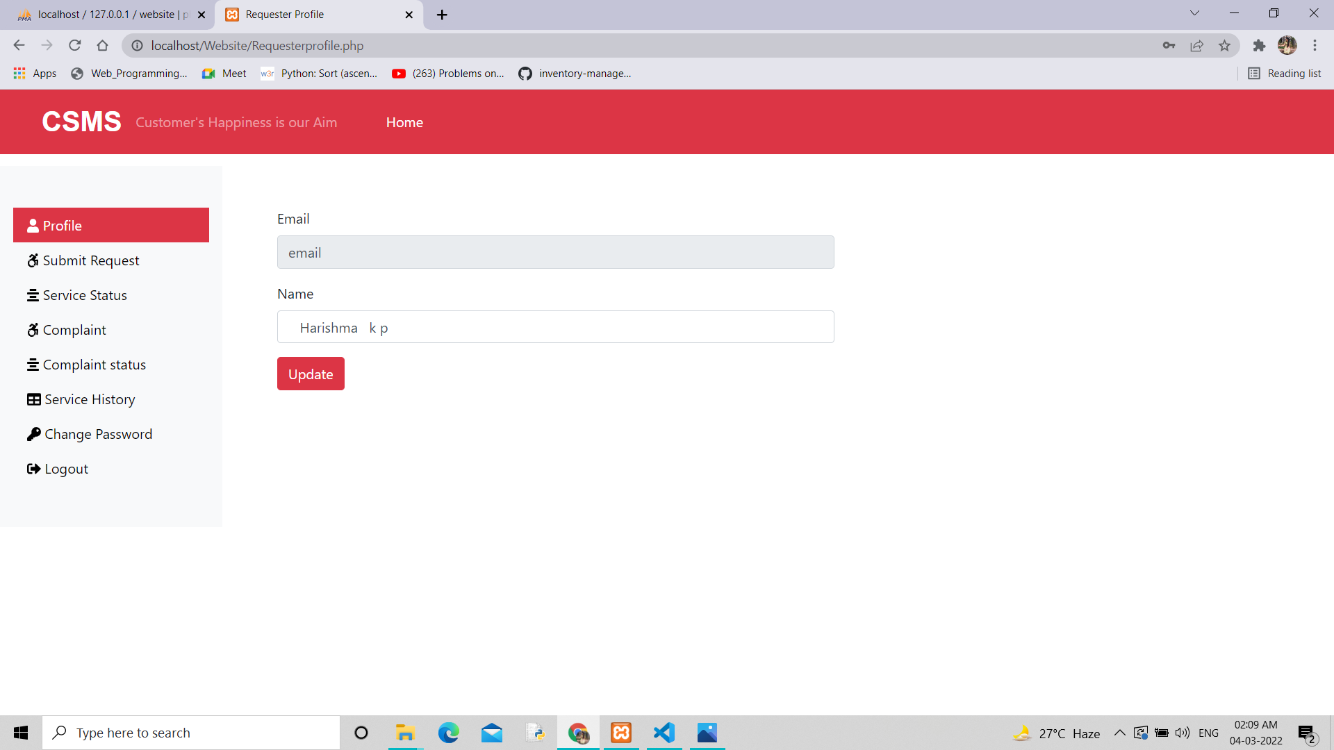

Slide 24
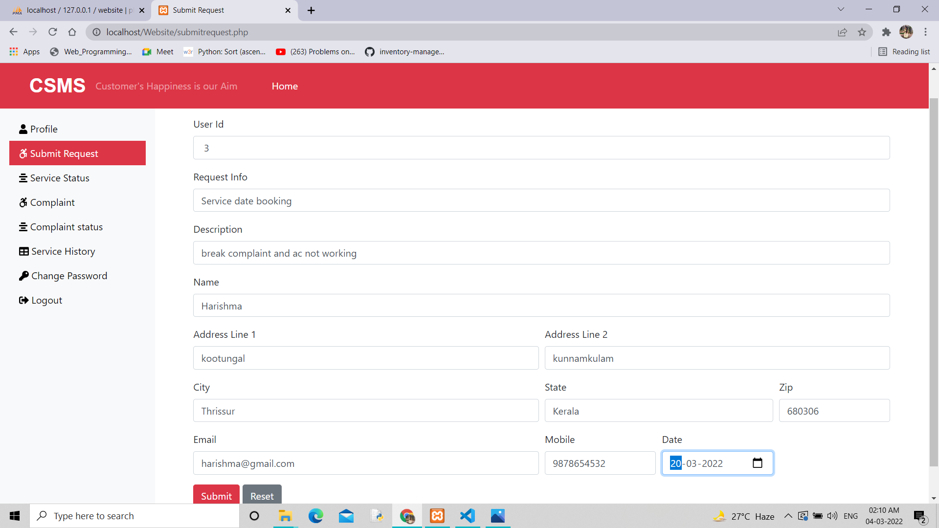

Slide 25
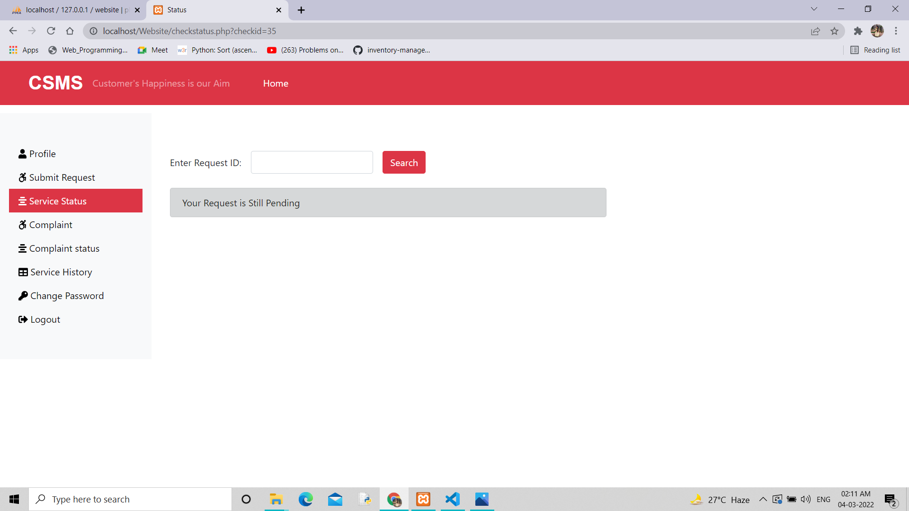

Slide 26
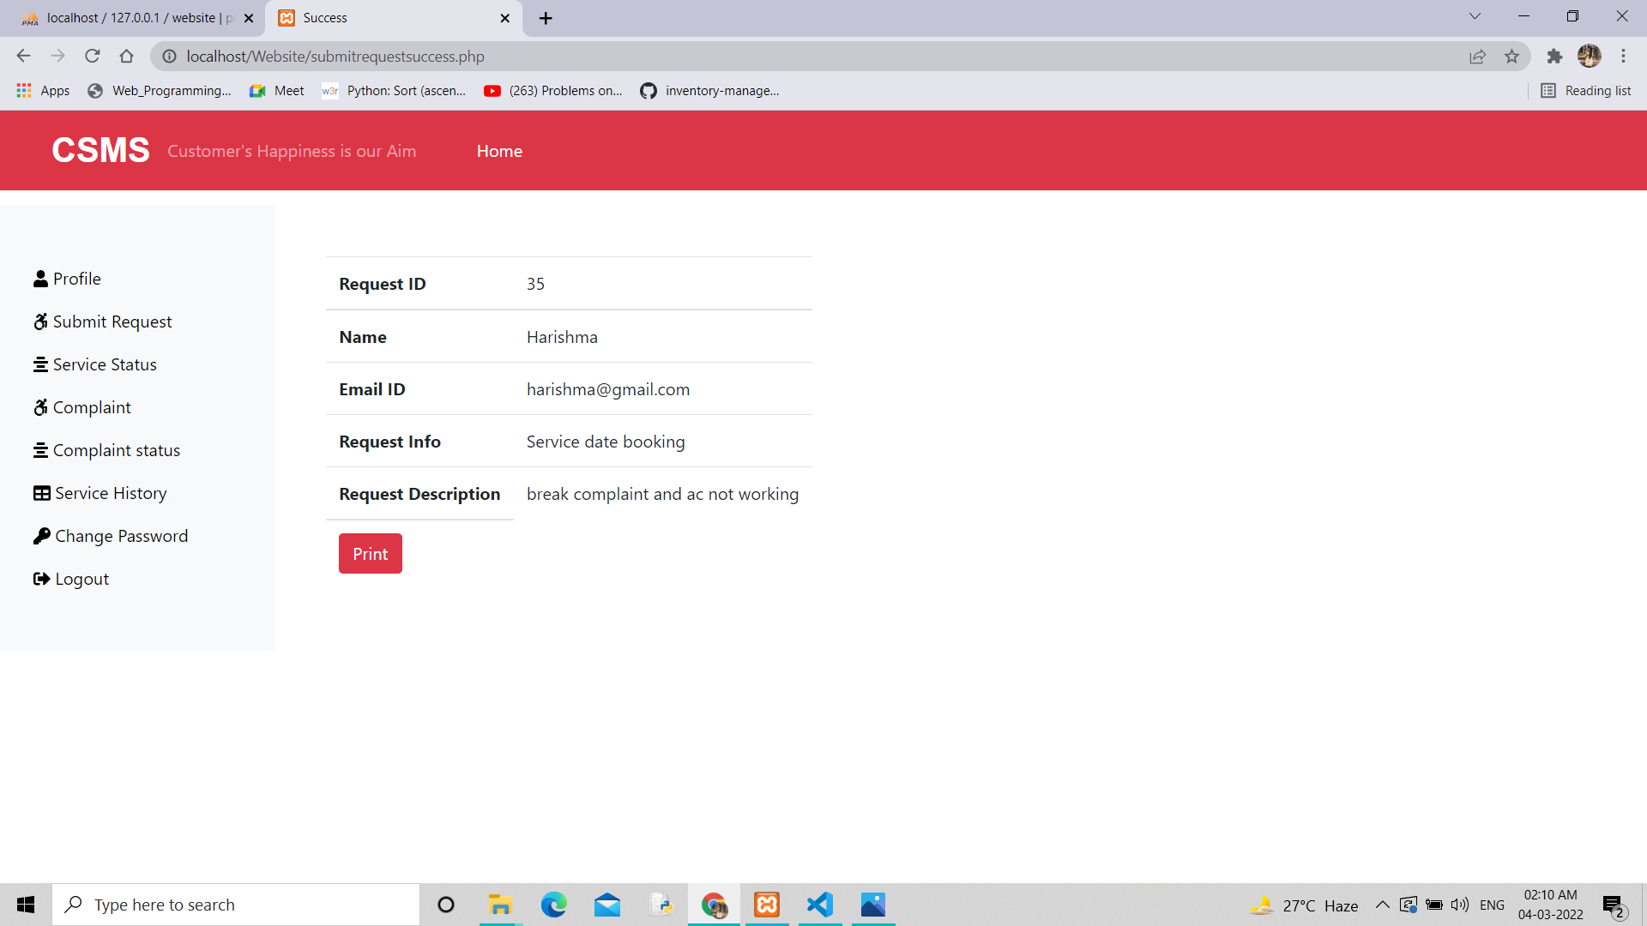

Slide 27
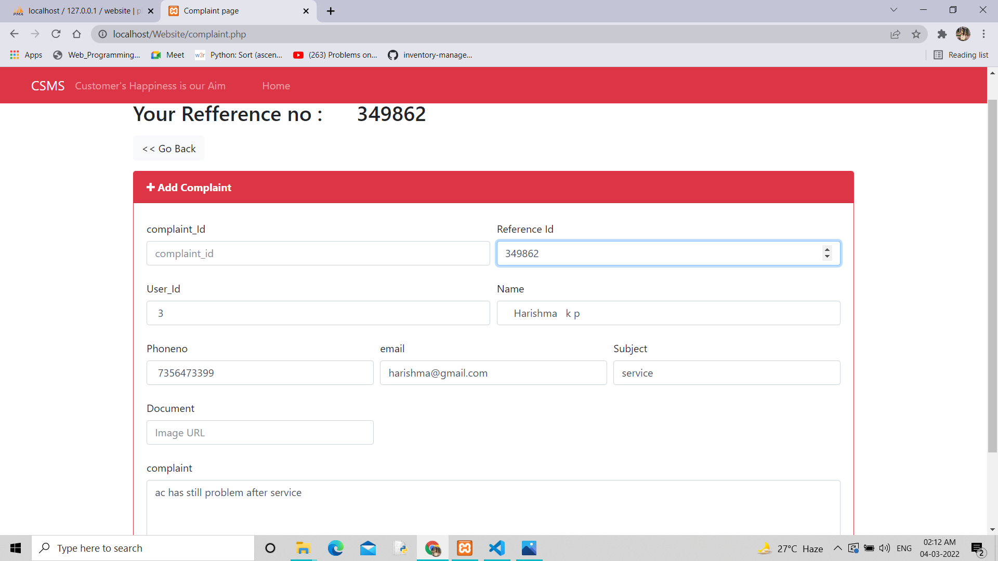

Slide 28
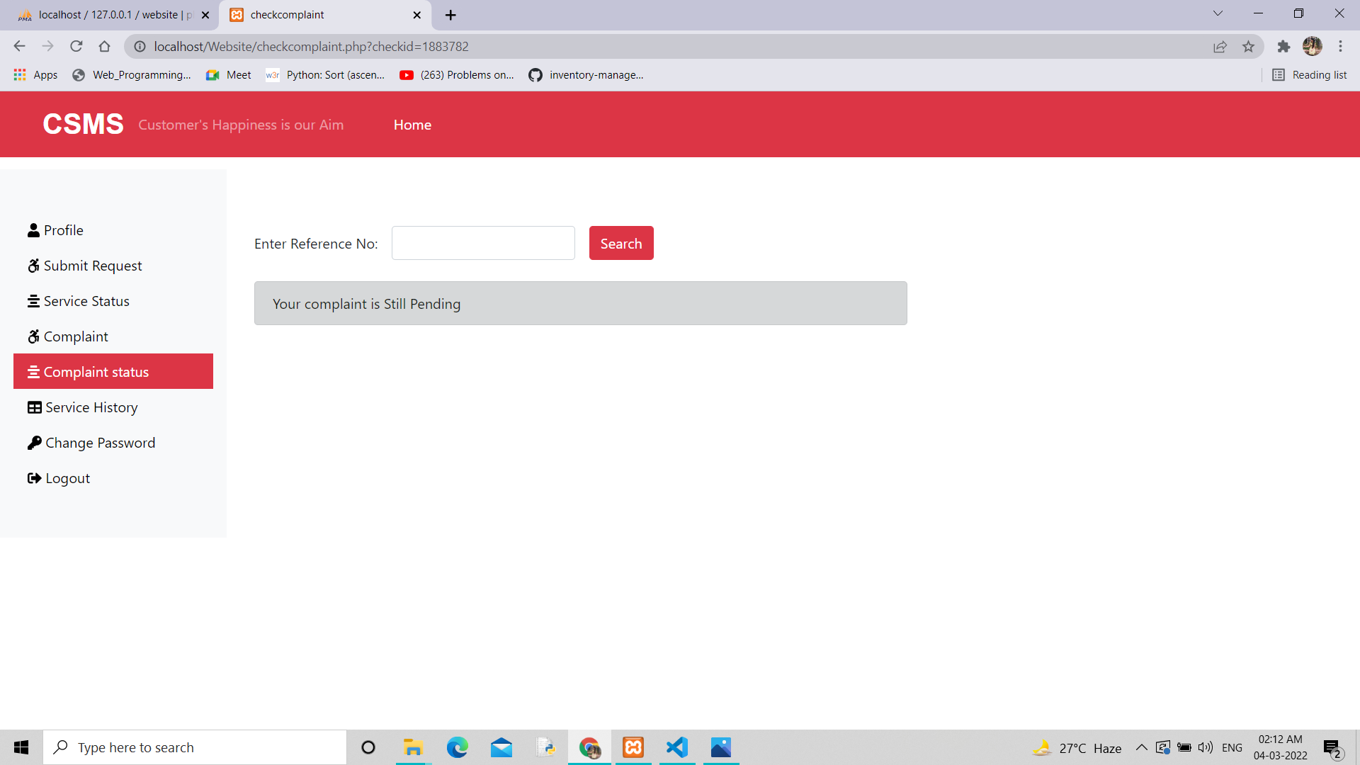

Slide 29
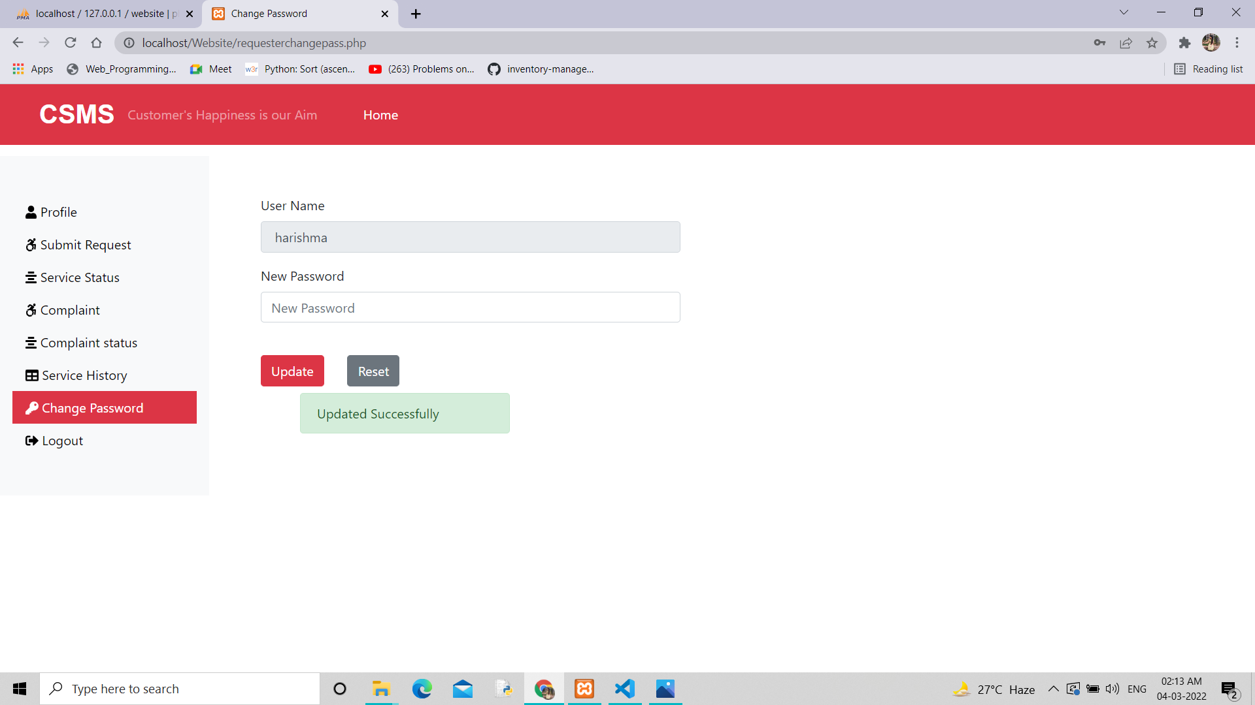

Slide 30
Admin Interface

Slide 31
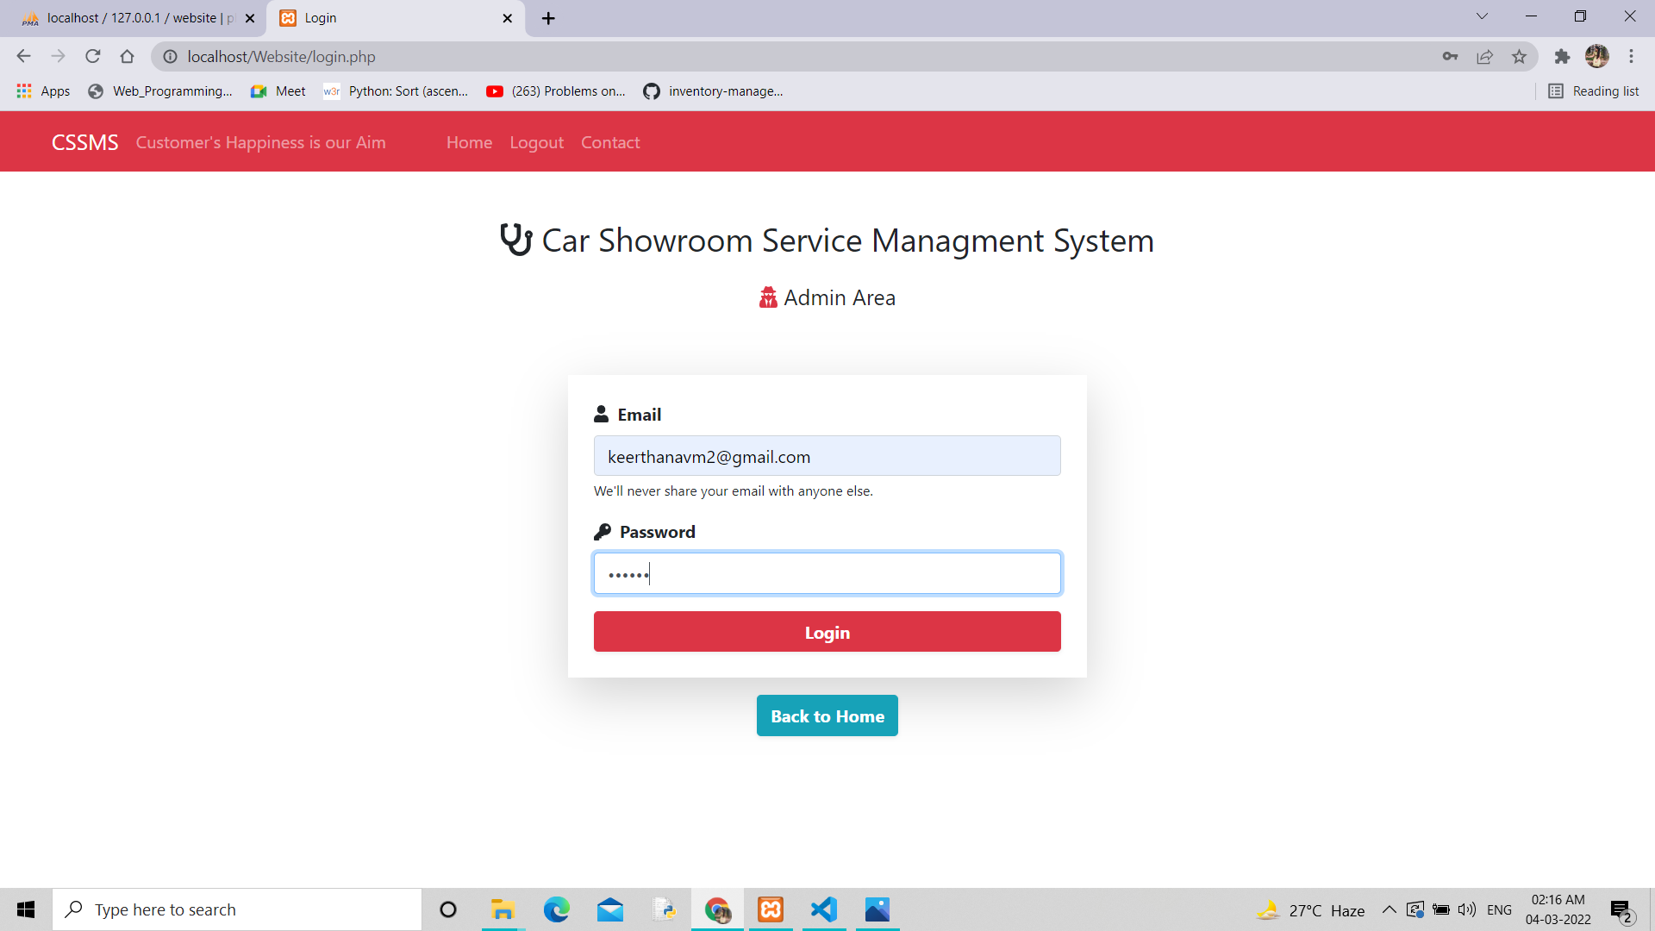

Slide 32
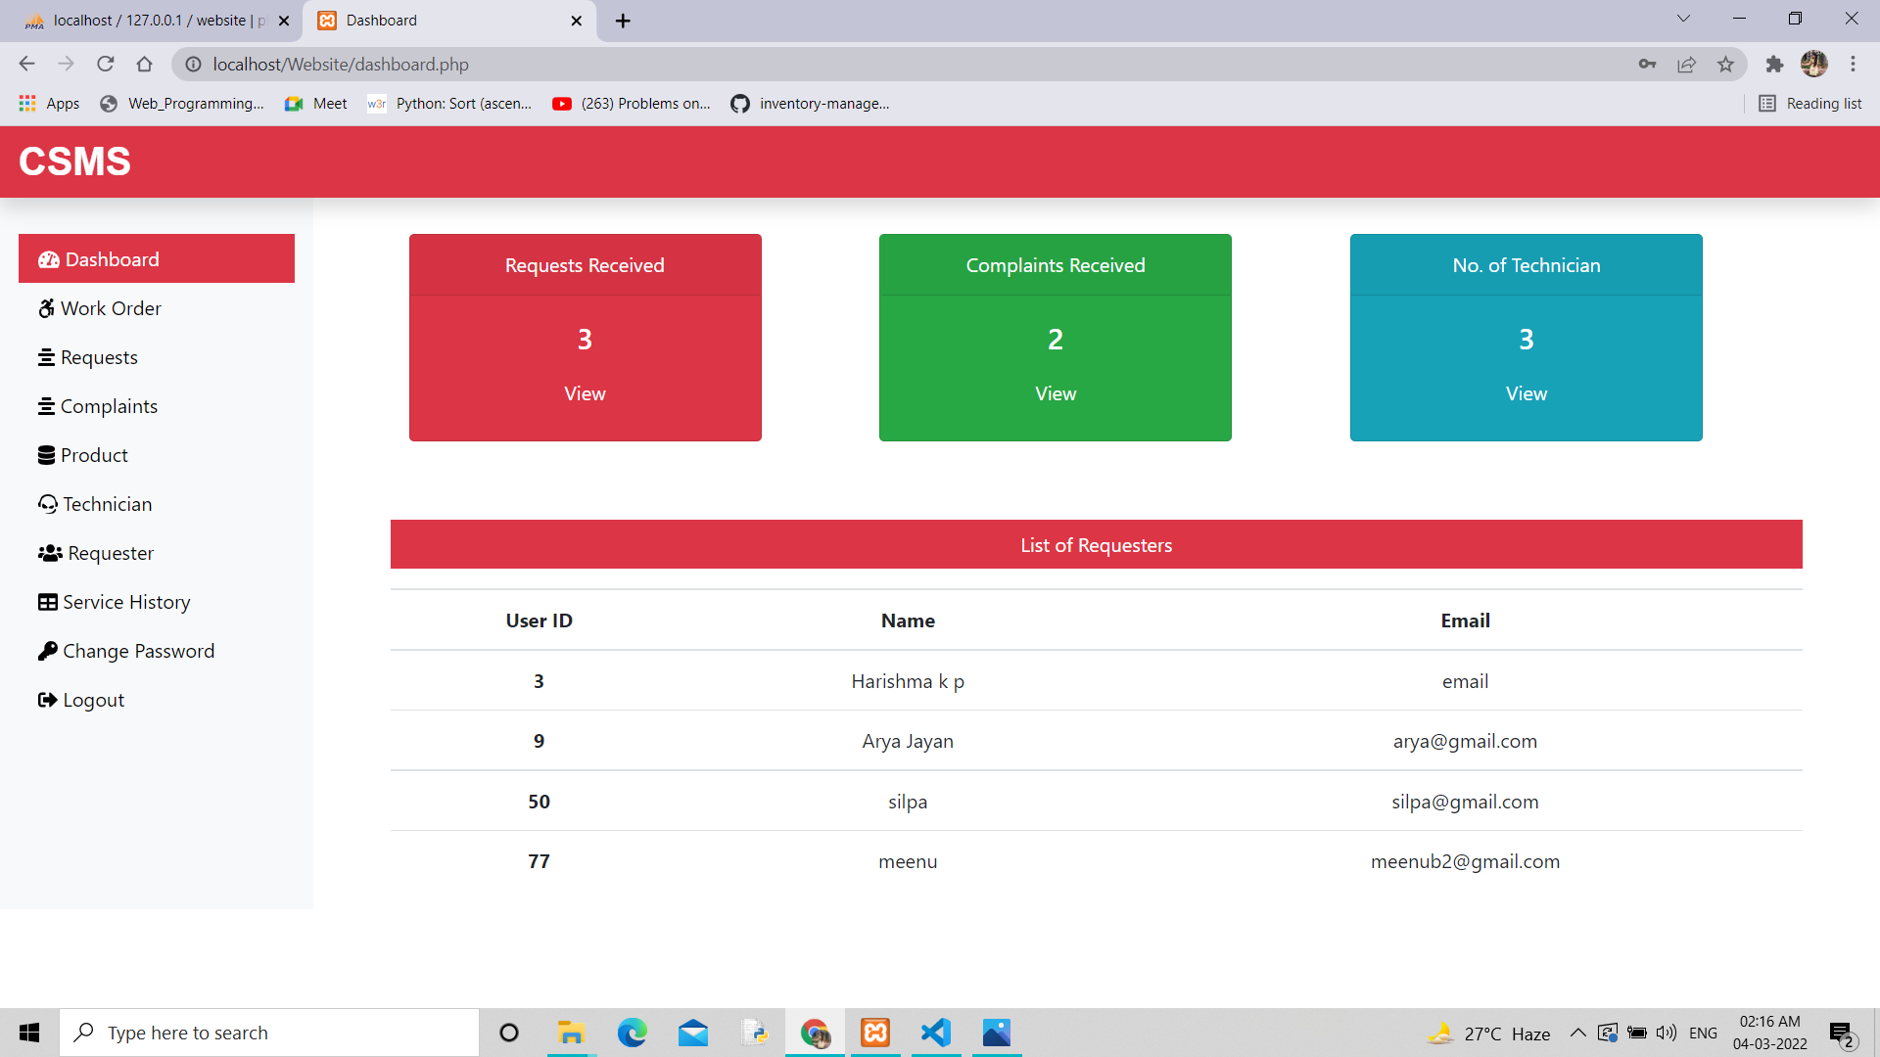

Slide 33
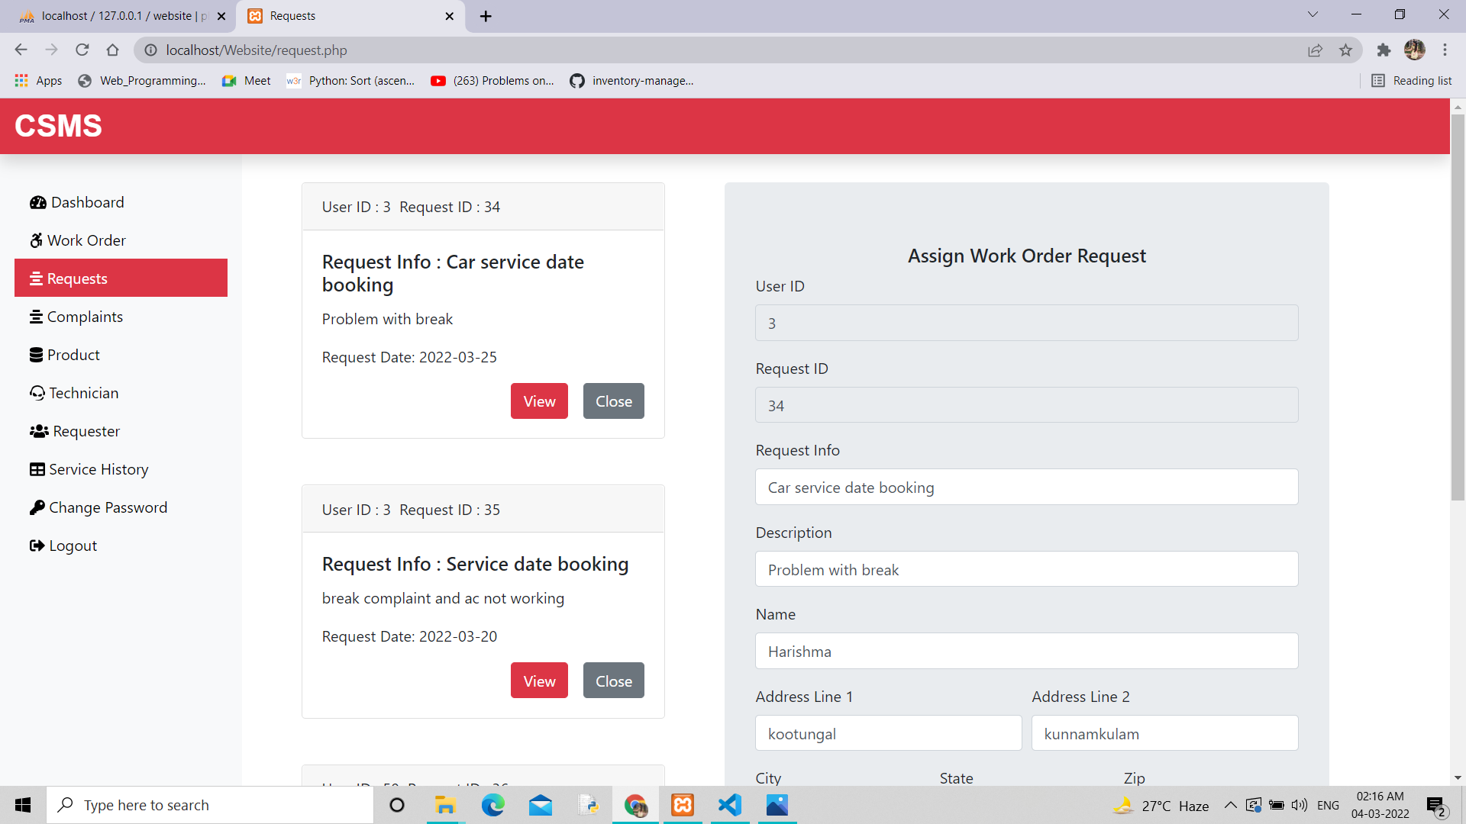

Slide 34
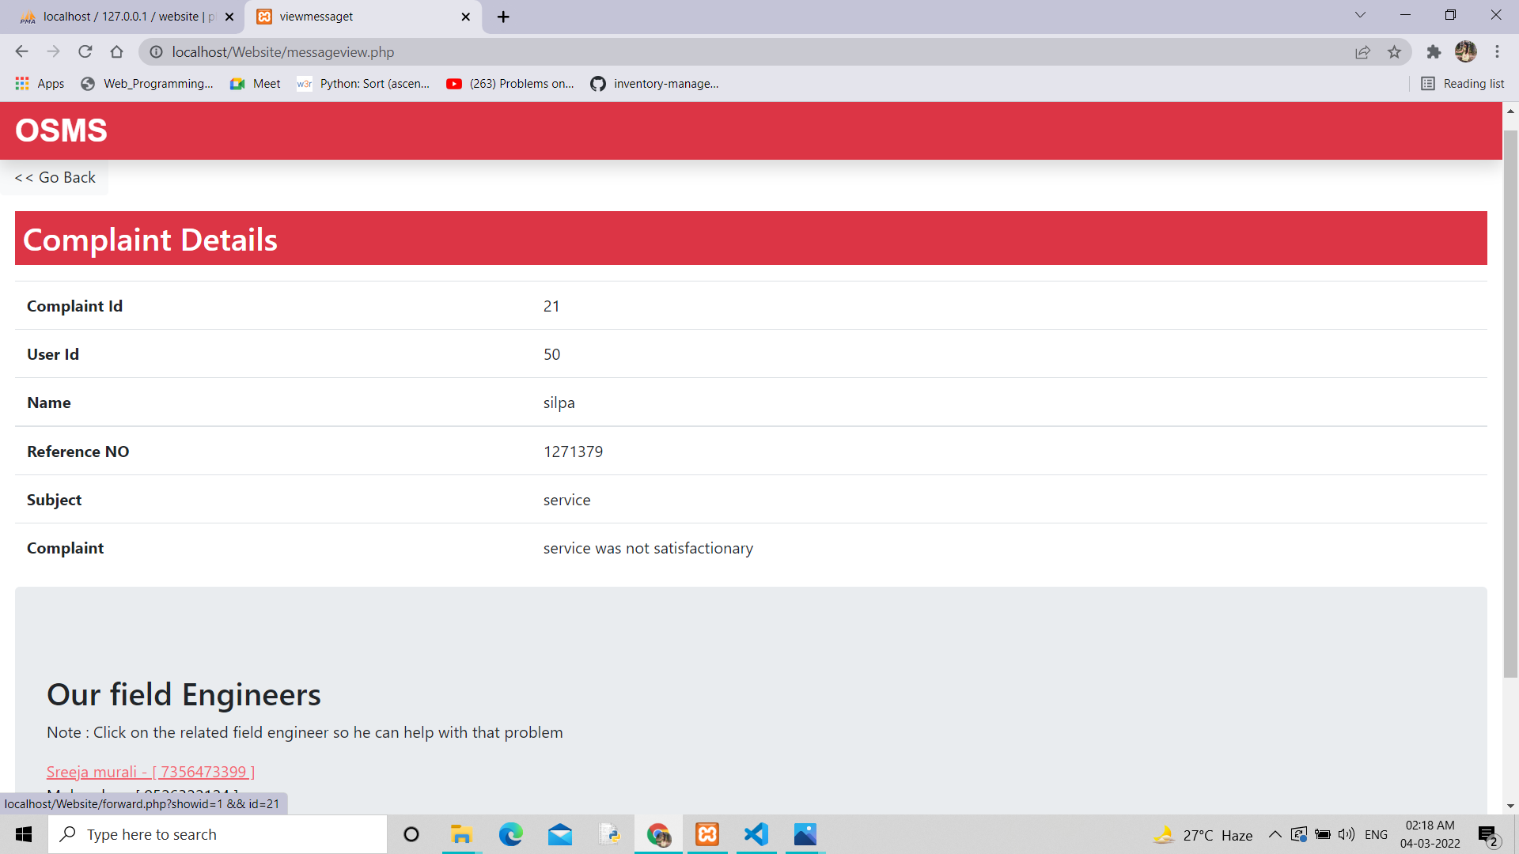

Slide 35
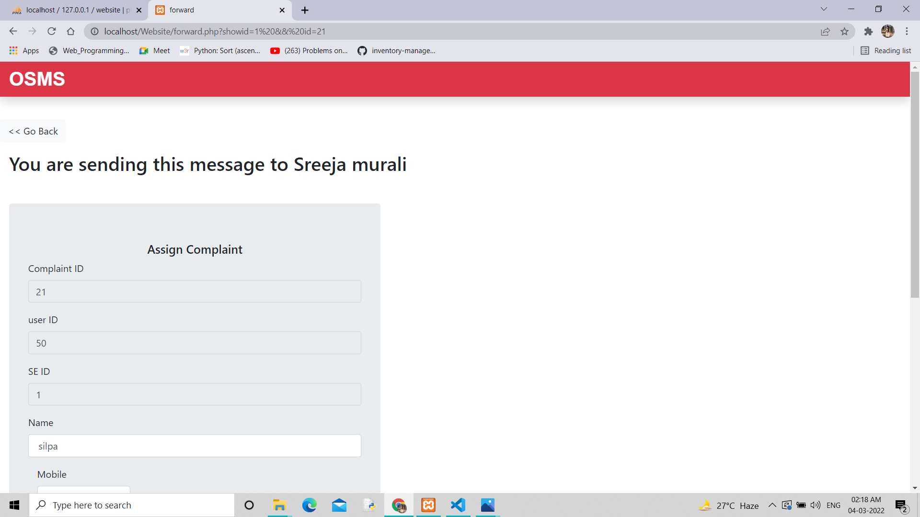

Slide 36
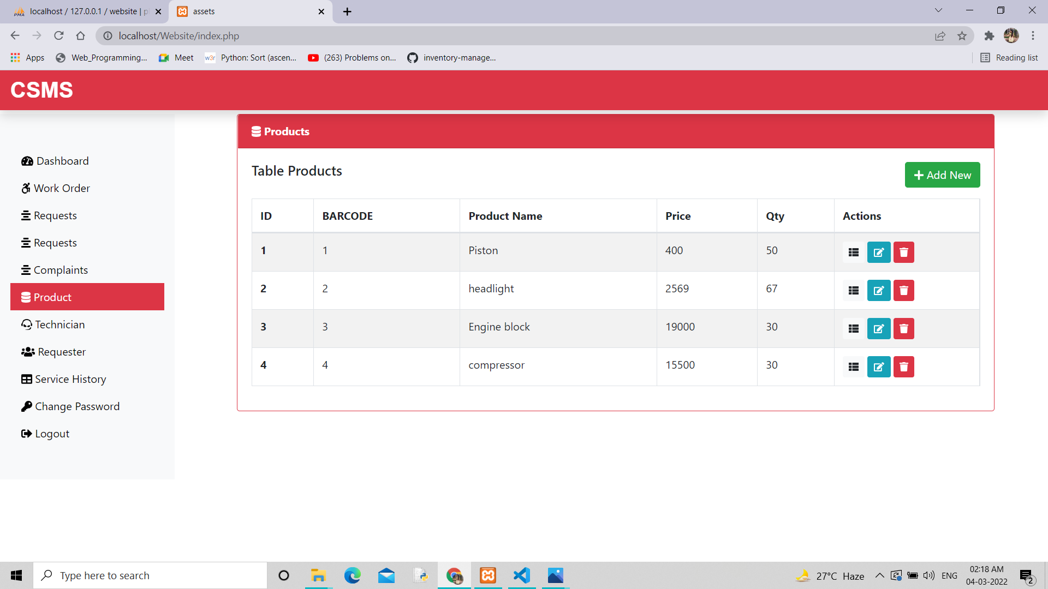

Slide 37
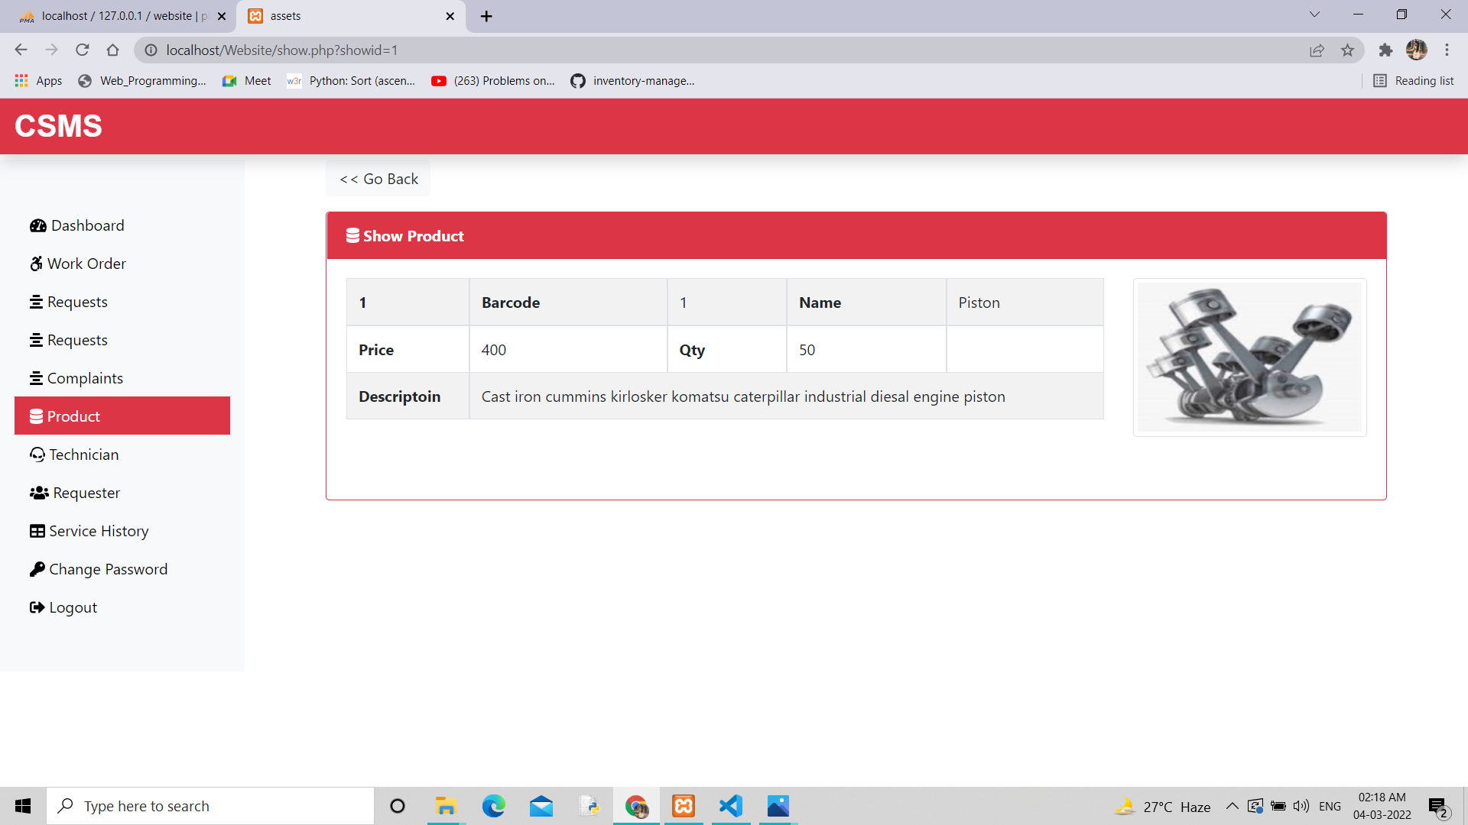

Slide 38
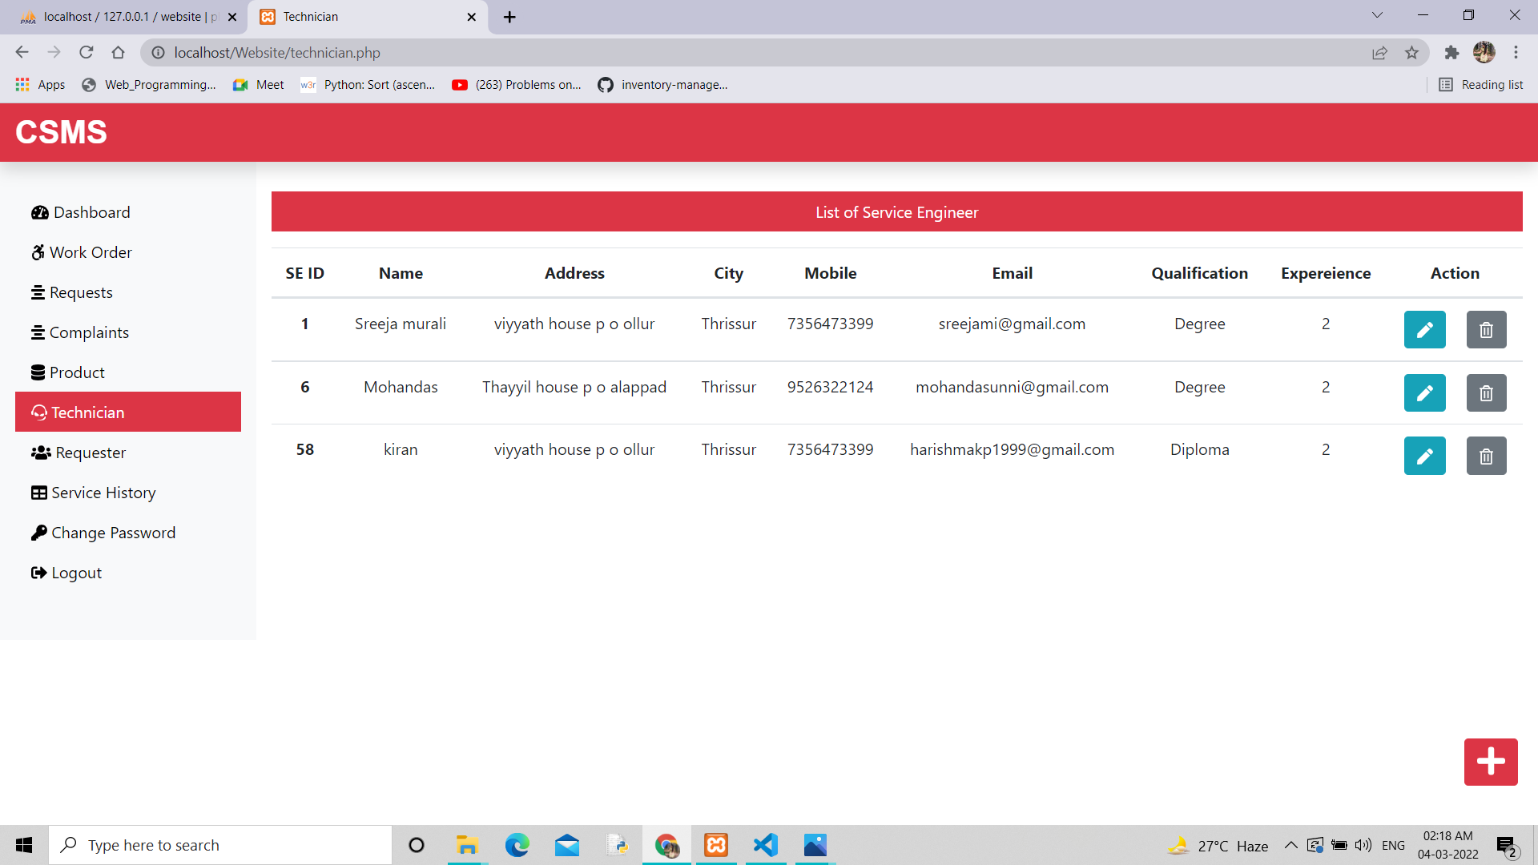

Slide 39
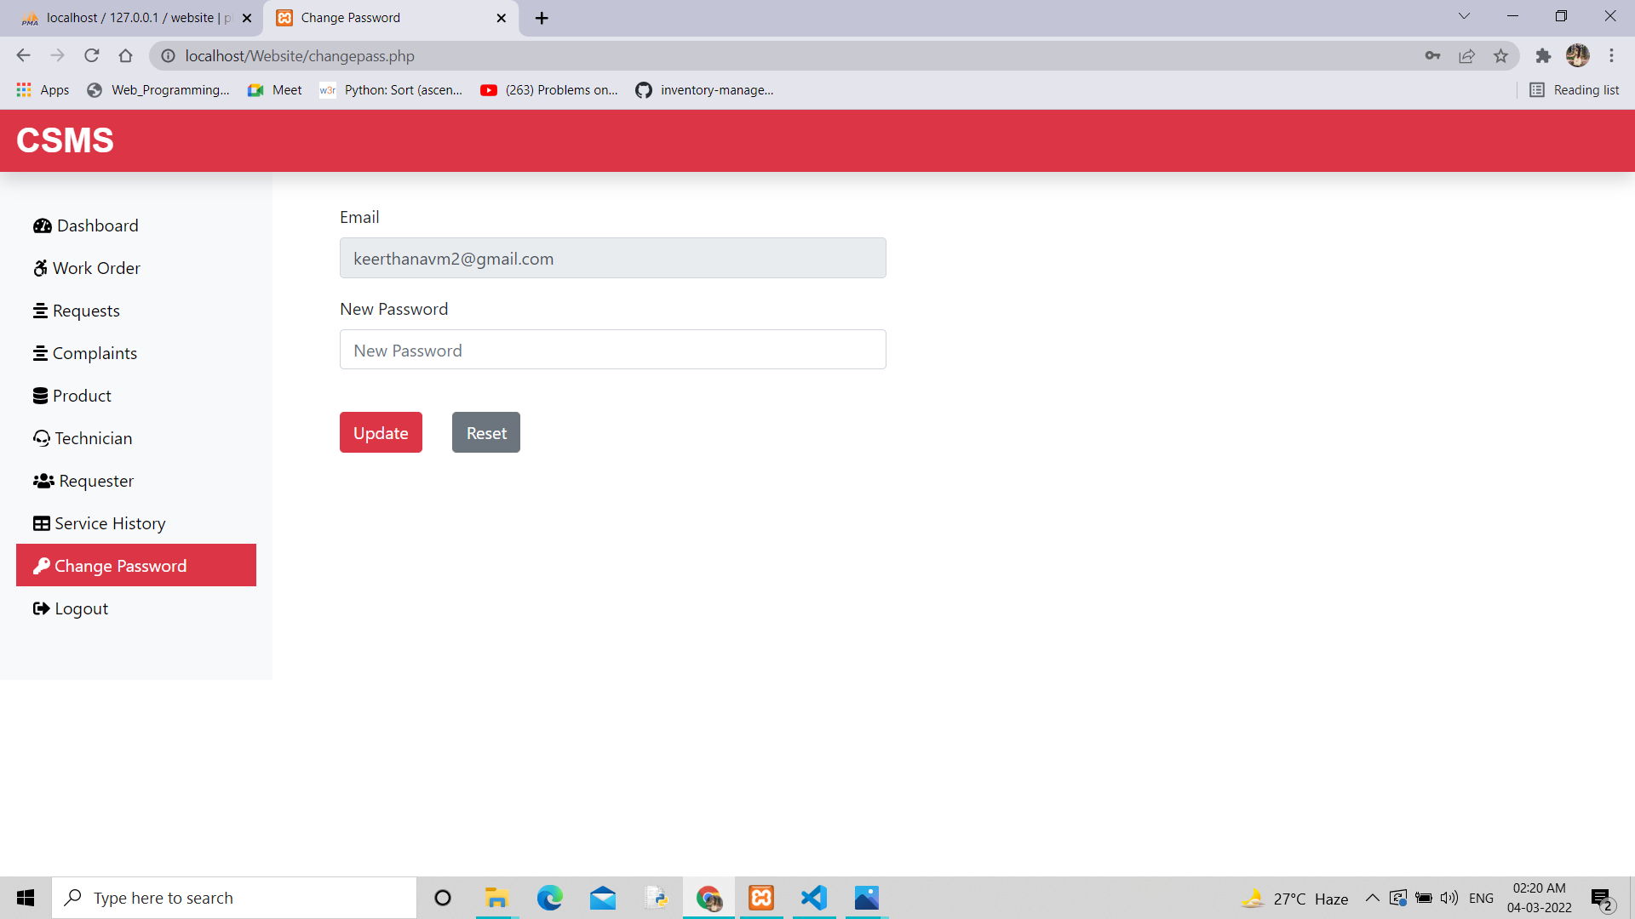

Slide 40
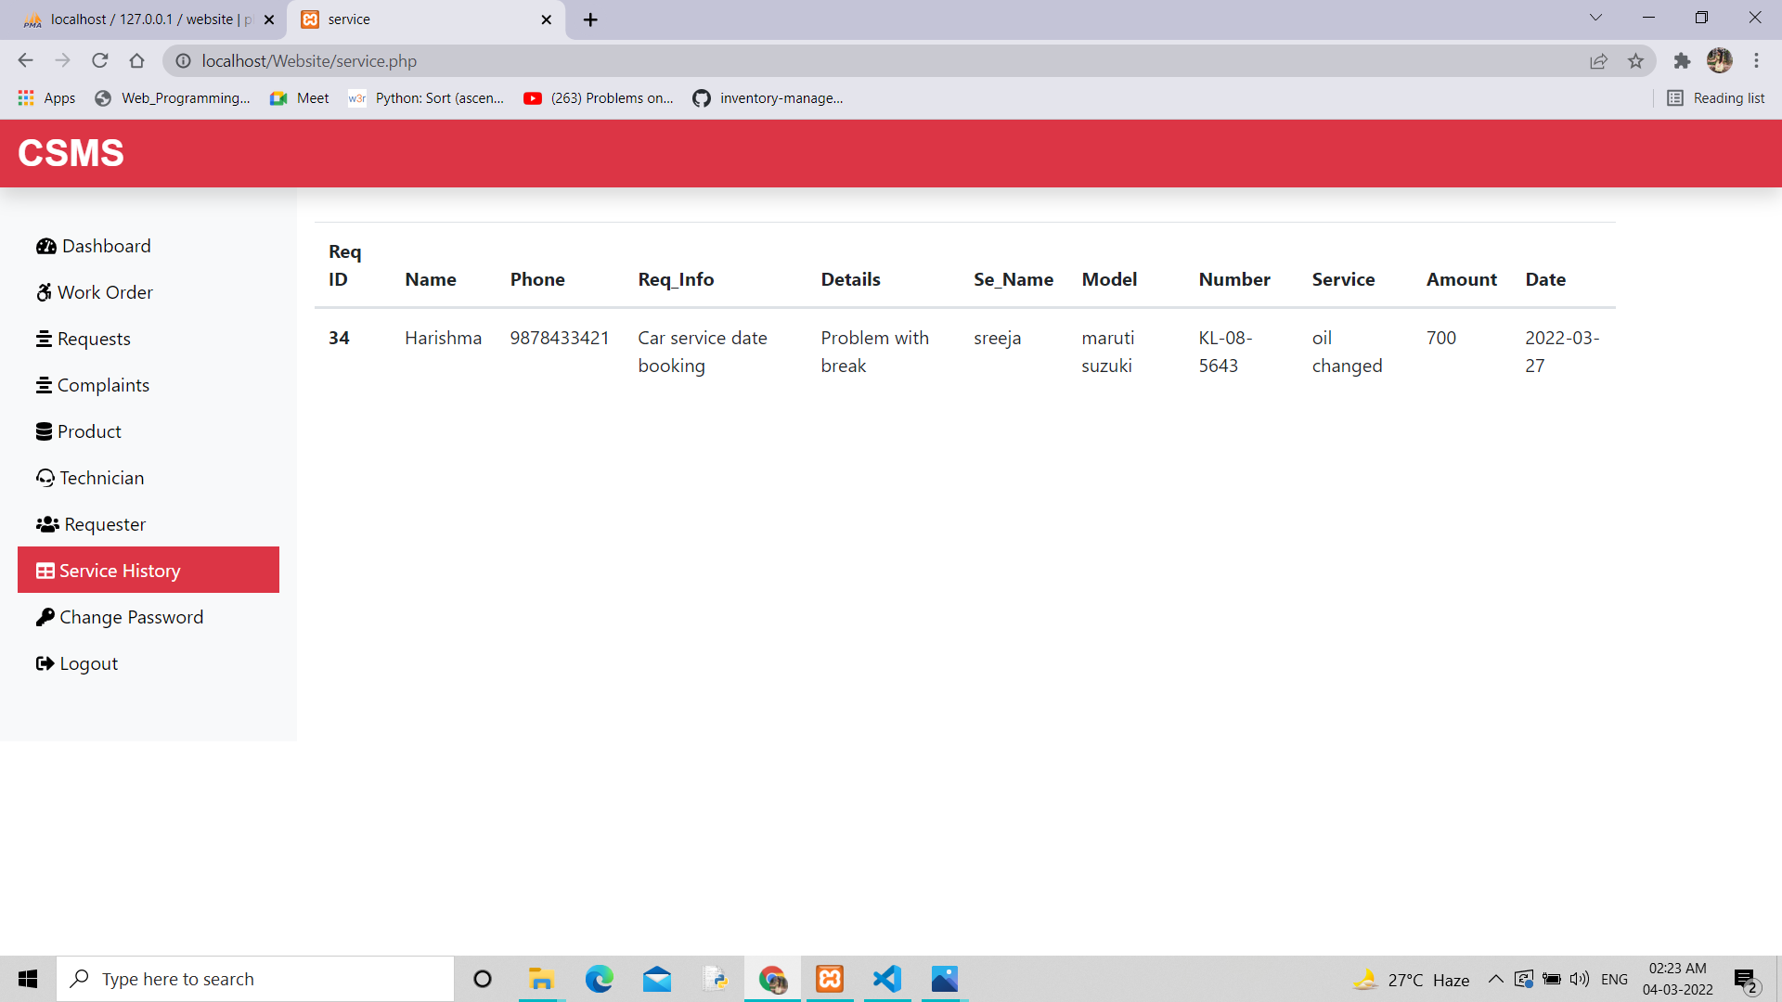

Slide 41
Service Engineer Interface

Slide 42
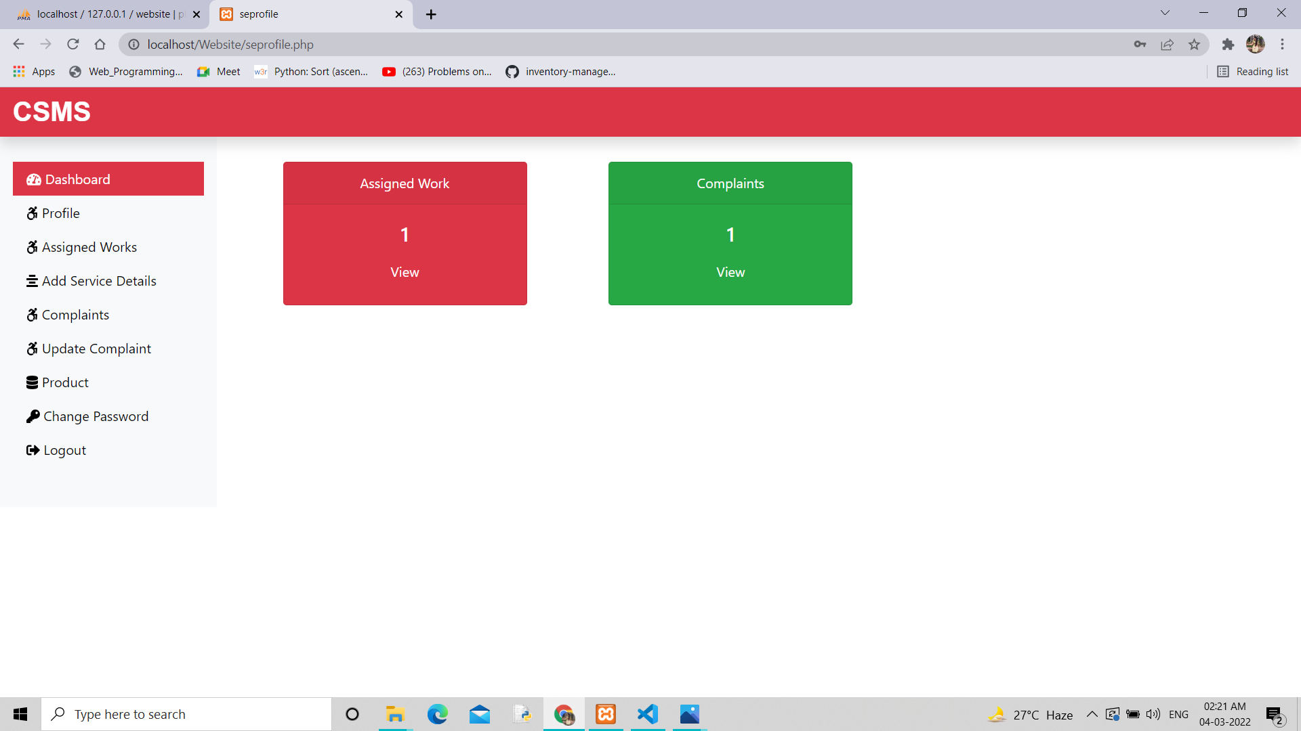

Slide 43
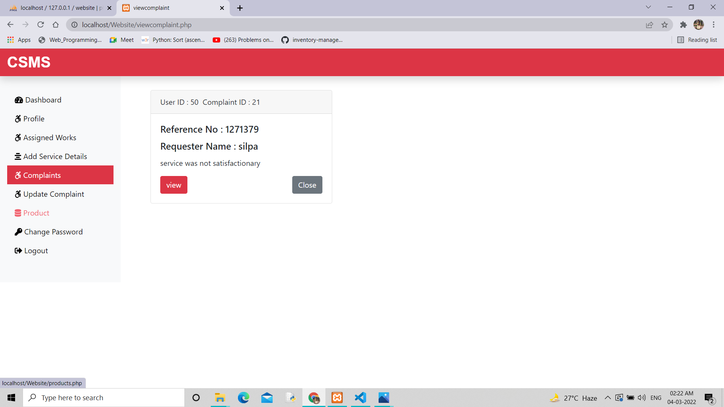

Slide 44
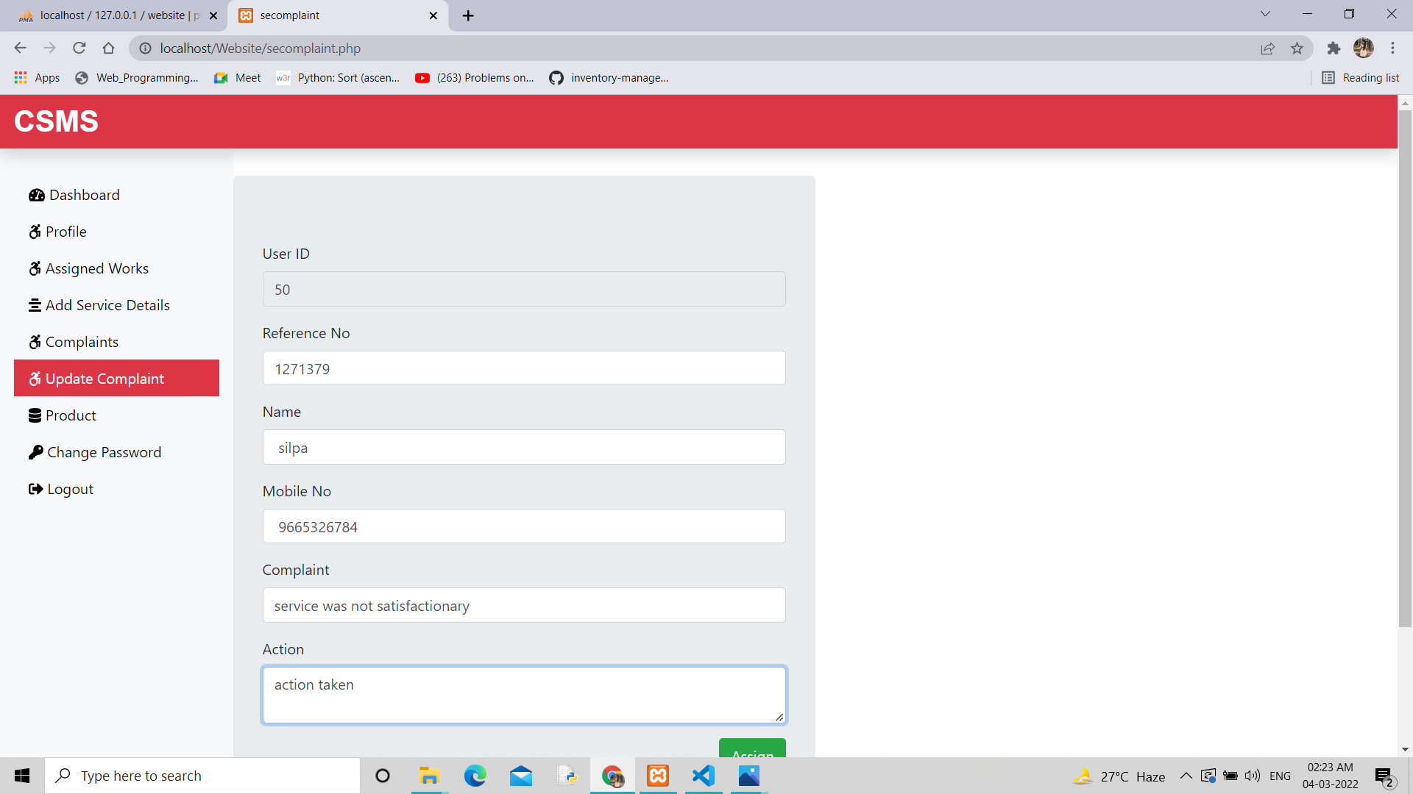

Slide 45
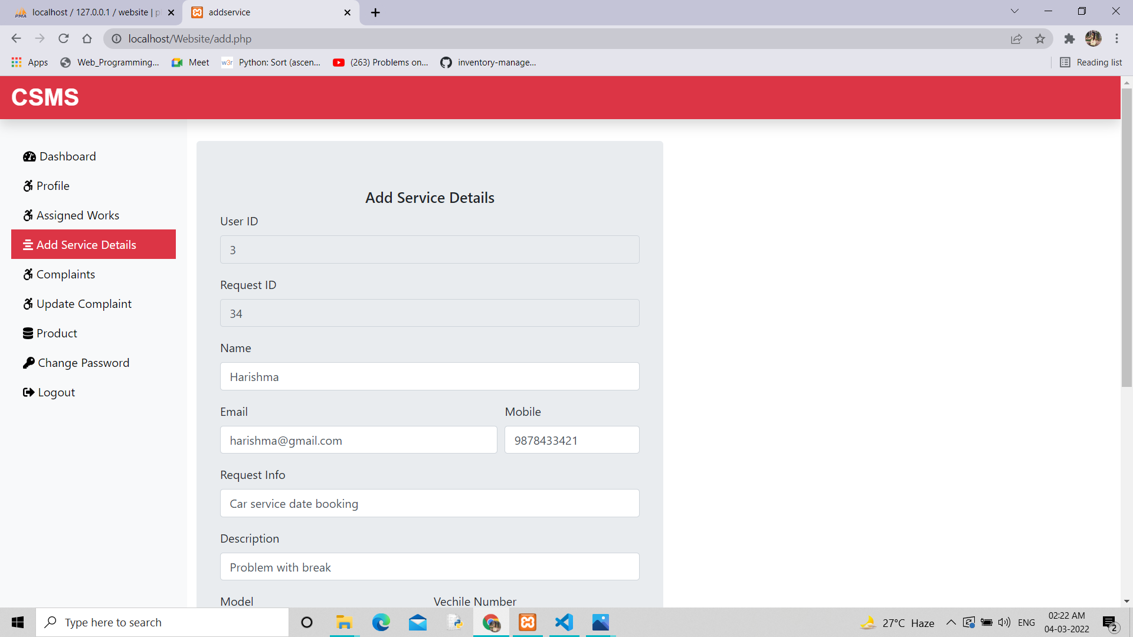
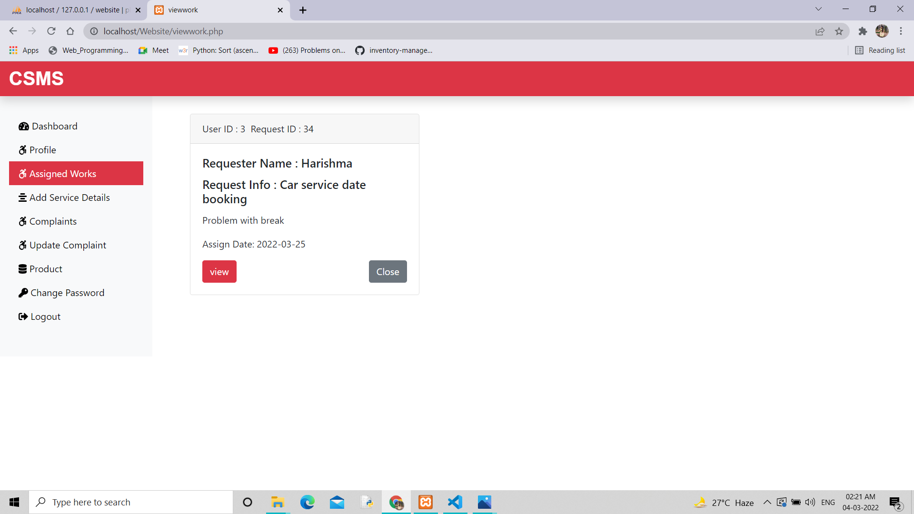

Slide 46
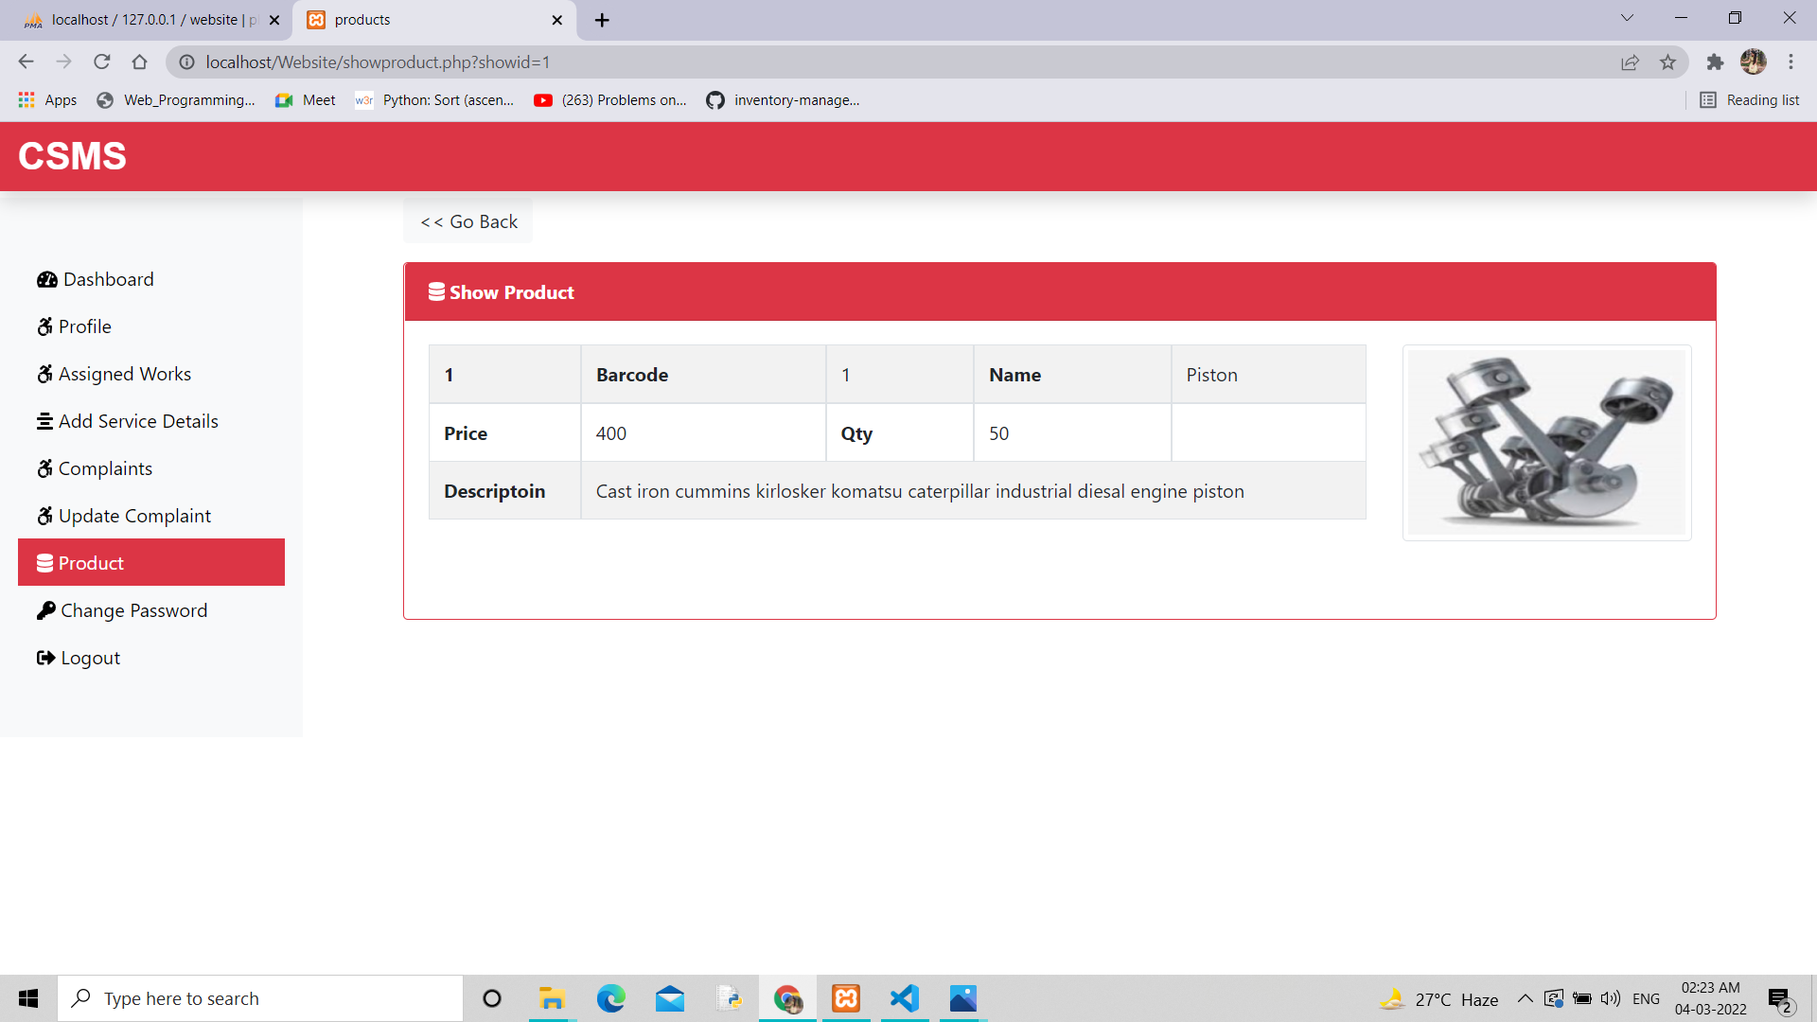

Slide 47
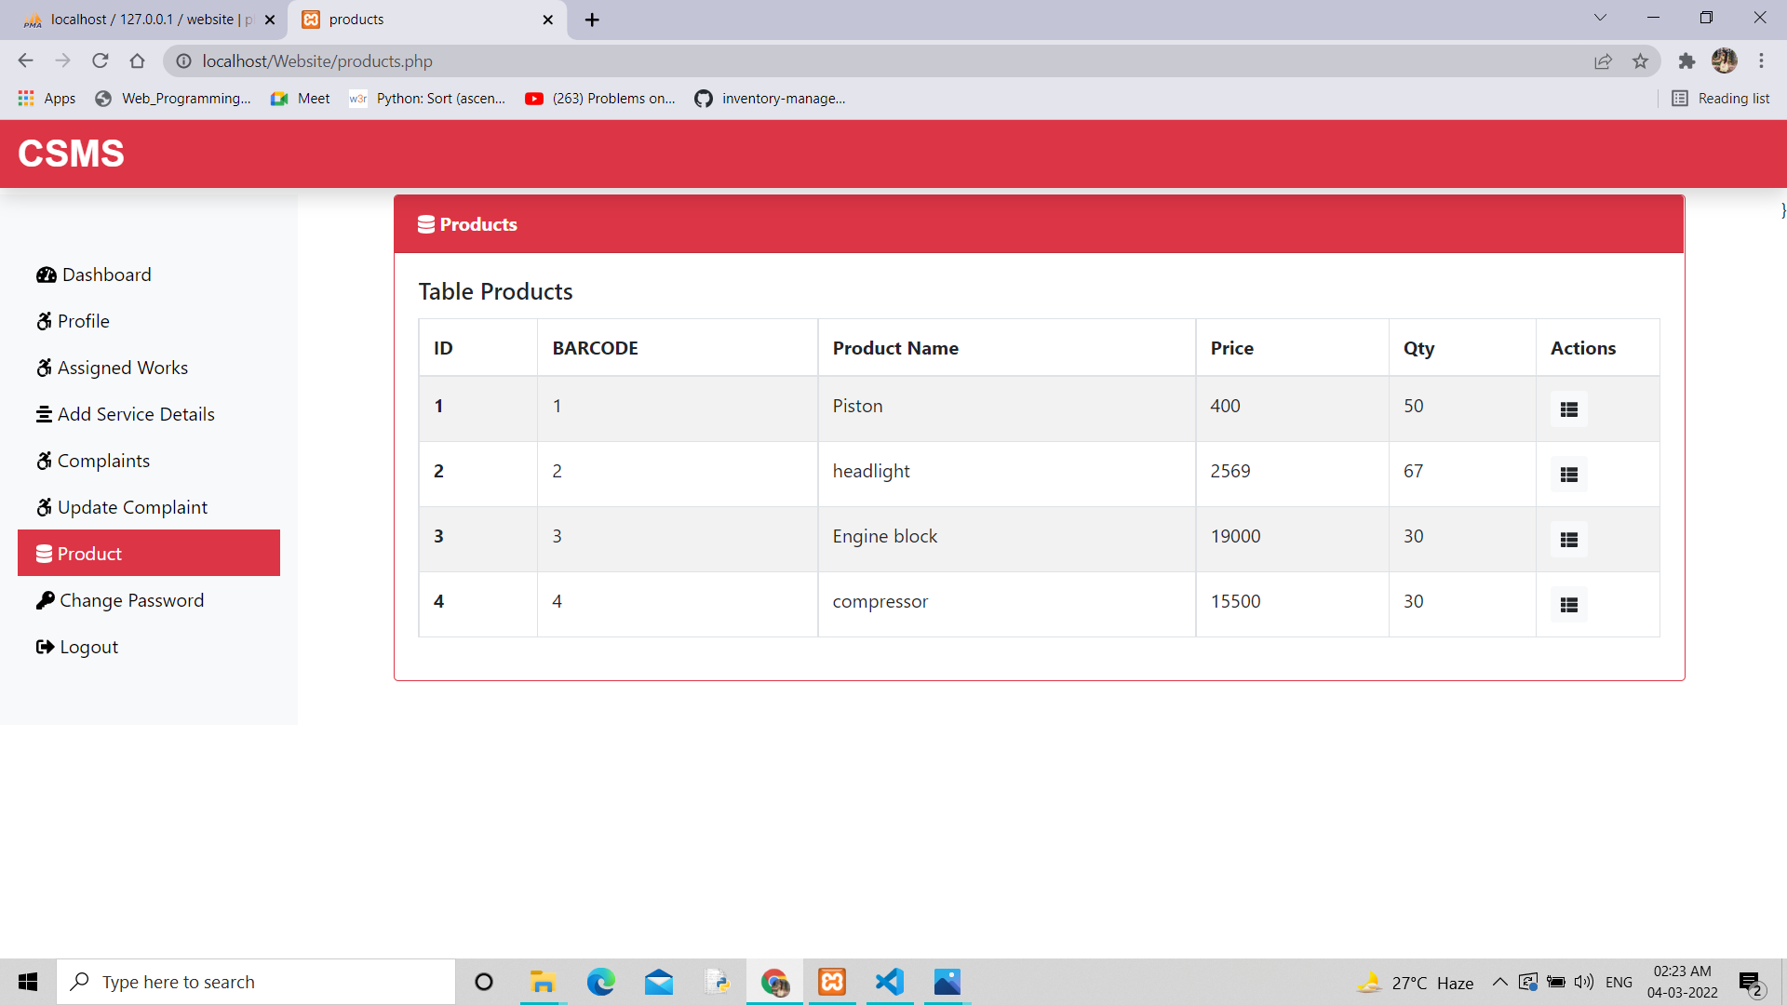

Slide 48
CONCLUSION
This is small scale project for online car showroom service .The basic idea is aimed to serve the interest of customers. In this website user can book their service date and post complaints. User can also view the status of their complaints and the past service details

Slide 49
Technologies Used
JS(Java Script)
HTML(Hyper Text Markup Language)
CSS(Cascading Style Sheet)
PHP

Slide 50
BIBLIOGRAPHY
Elias.M.Awad, System Analysis and Design, McGraw-Hill,2’nd edition.
Ian Gorton Springer, Essential software project Management, 4-th Edition
http://en.Wikipedia.org/wiki/Class_diagram.

Slide 51
THANK YOU

